Slide 1

AWS MINI PROJECT
-VEERA REDDY INAKOLLU

Slide 2
CONTENTS:
IAM(IDENTITY AND ACCESS MANAGEMENT)
BILLING ALARM
S3 BUCKET (SIMPLE STRONG SERVICE)
EC2 INSTANCE (ELASTIC COMPUTE CLOUD)
SECURITY GROUPS
VOLUMES AND SNAPCHARTS
AMI’s (AMAZON MACHINE IMAGE)
LOAD BALANCER
ASG AND LT (AUTO SCALING GROUP AND LAUNCH TEMPLET)
RDS (RELATIONAL DATABASE MANAGEMENT SYSTEM)

Slide 3
IAM(IDENTITY AND ACCESS MANAGEMENT) IAM in AWS is a service that helps you manage access to AWS resources securely.
KEY FEATURES :
USERS: Represent individual identities with specific permissions.
GROUPS:A collection of users that share similar permissions
ROLES: IAM roles are used to delegate access to users, applications, or services that don't normally have access to AWS resources.
POLICIES : Some permissions and are attached to users, groups, or roles.
MFA: Enhances security by requiring users to provide additional authentication methods beyond just passwords.

Slide 4
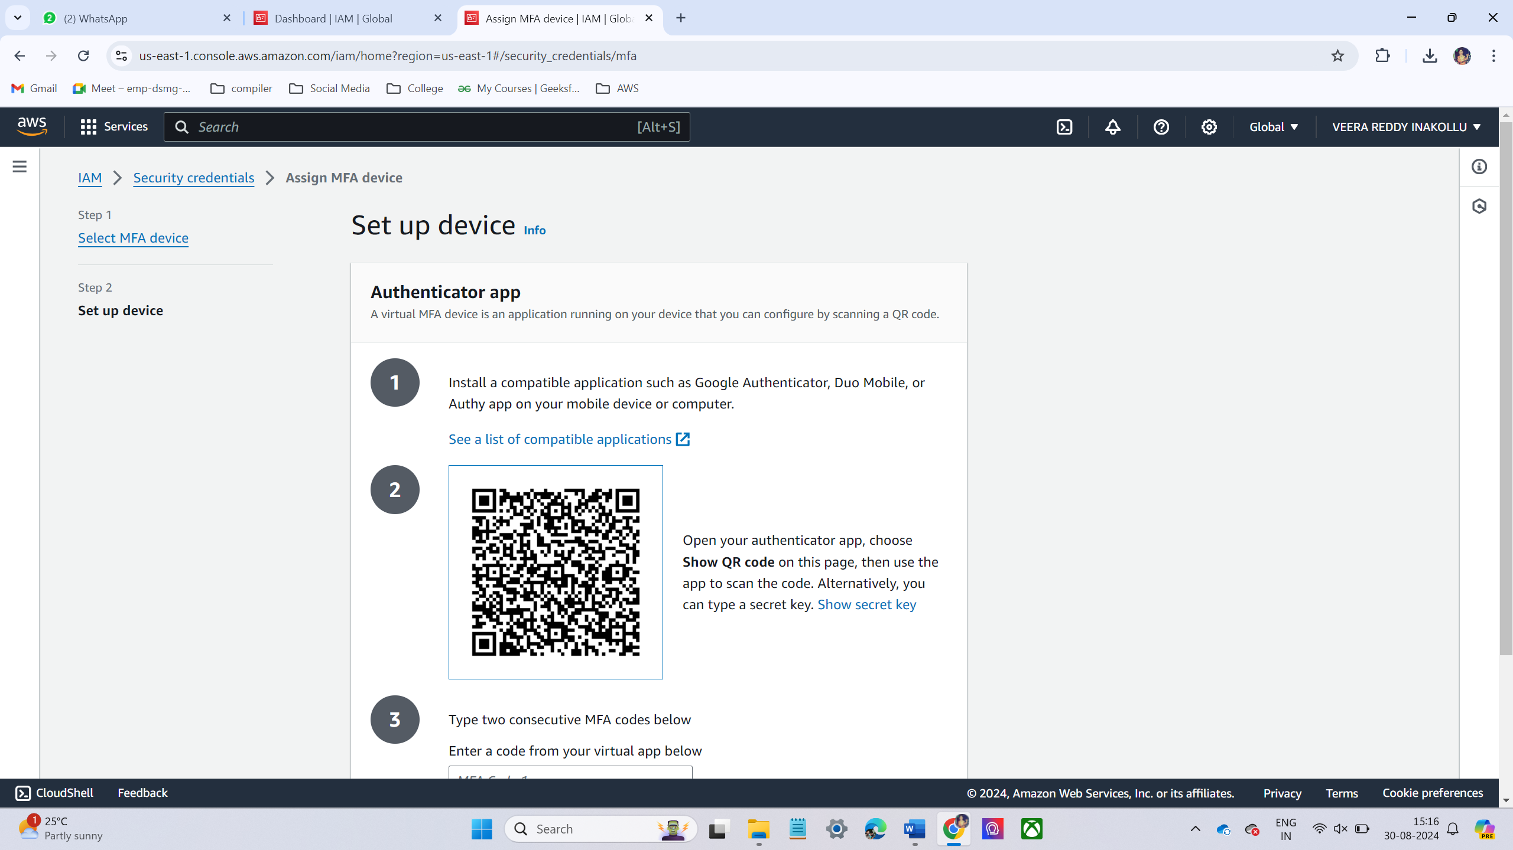
LAB 1 : IAM HANDS ON
SETUP MFA FOR ROOT USER:
Choose device name
Select the device Options. I have chosen Authenticator App.
It will show QR code like this.

Slide 5
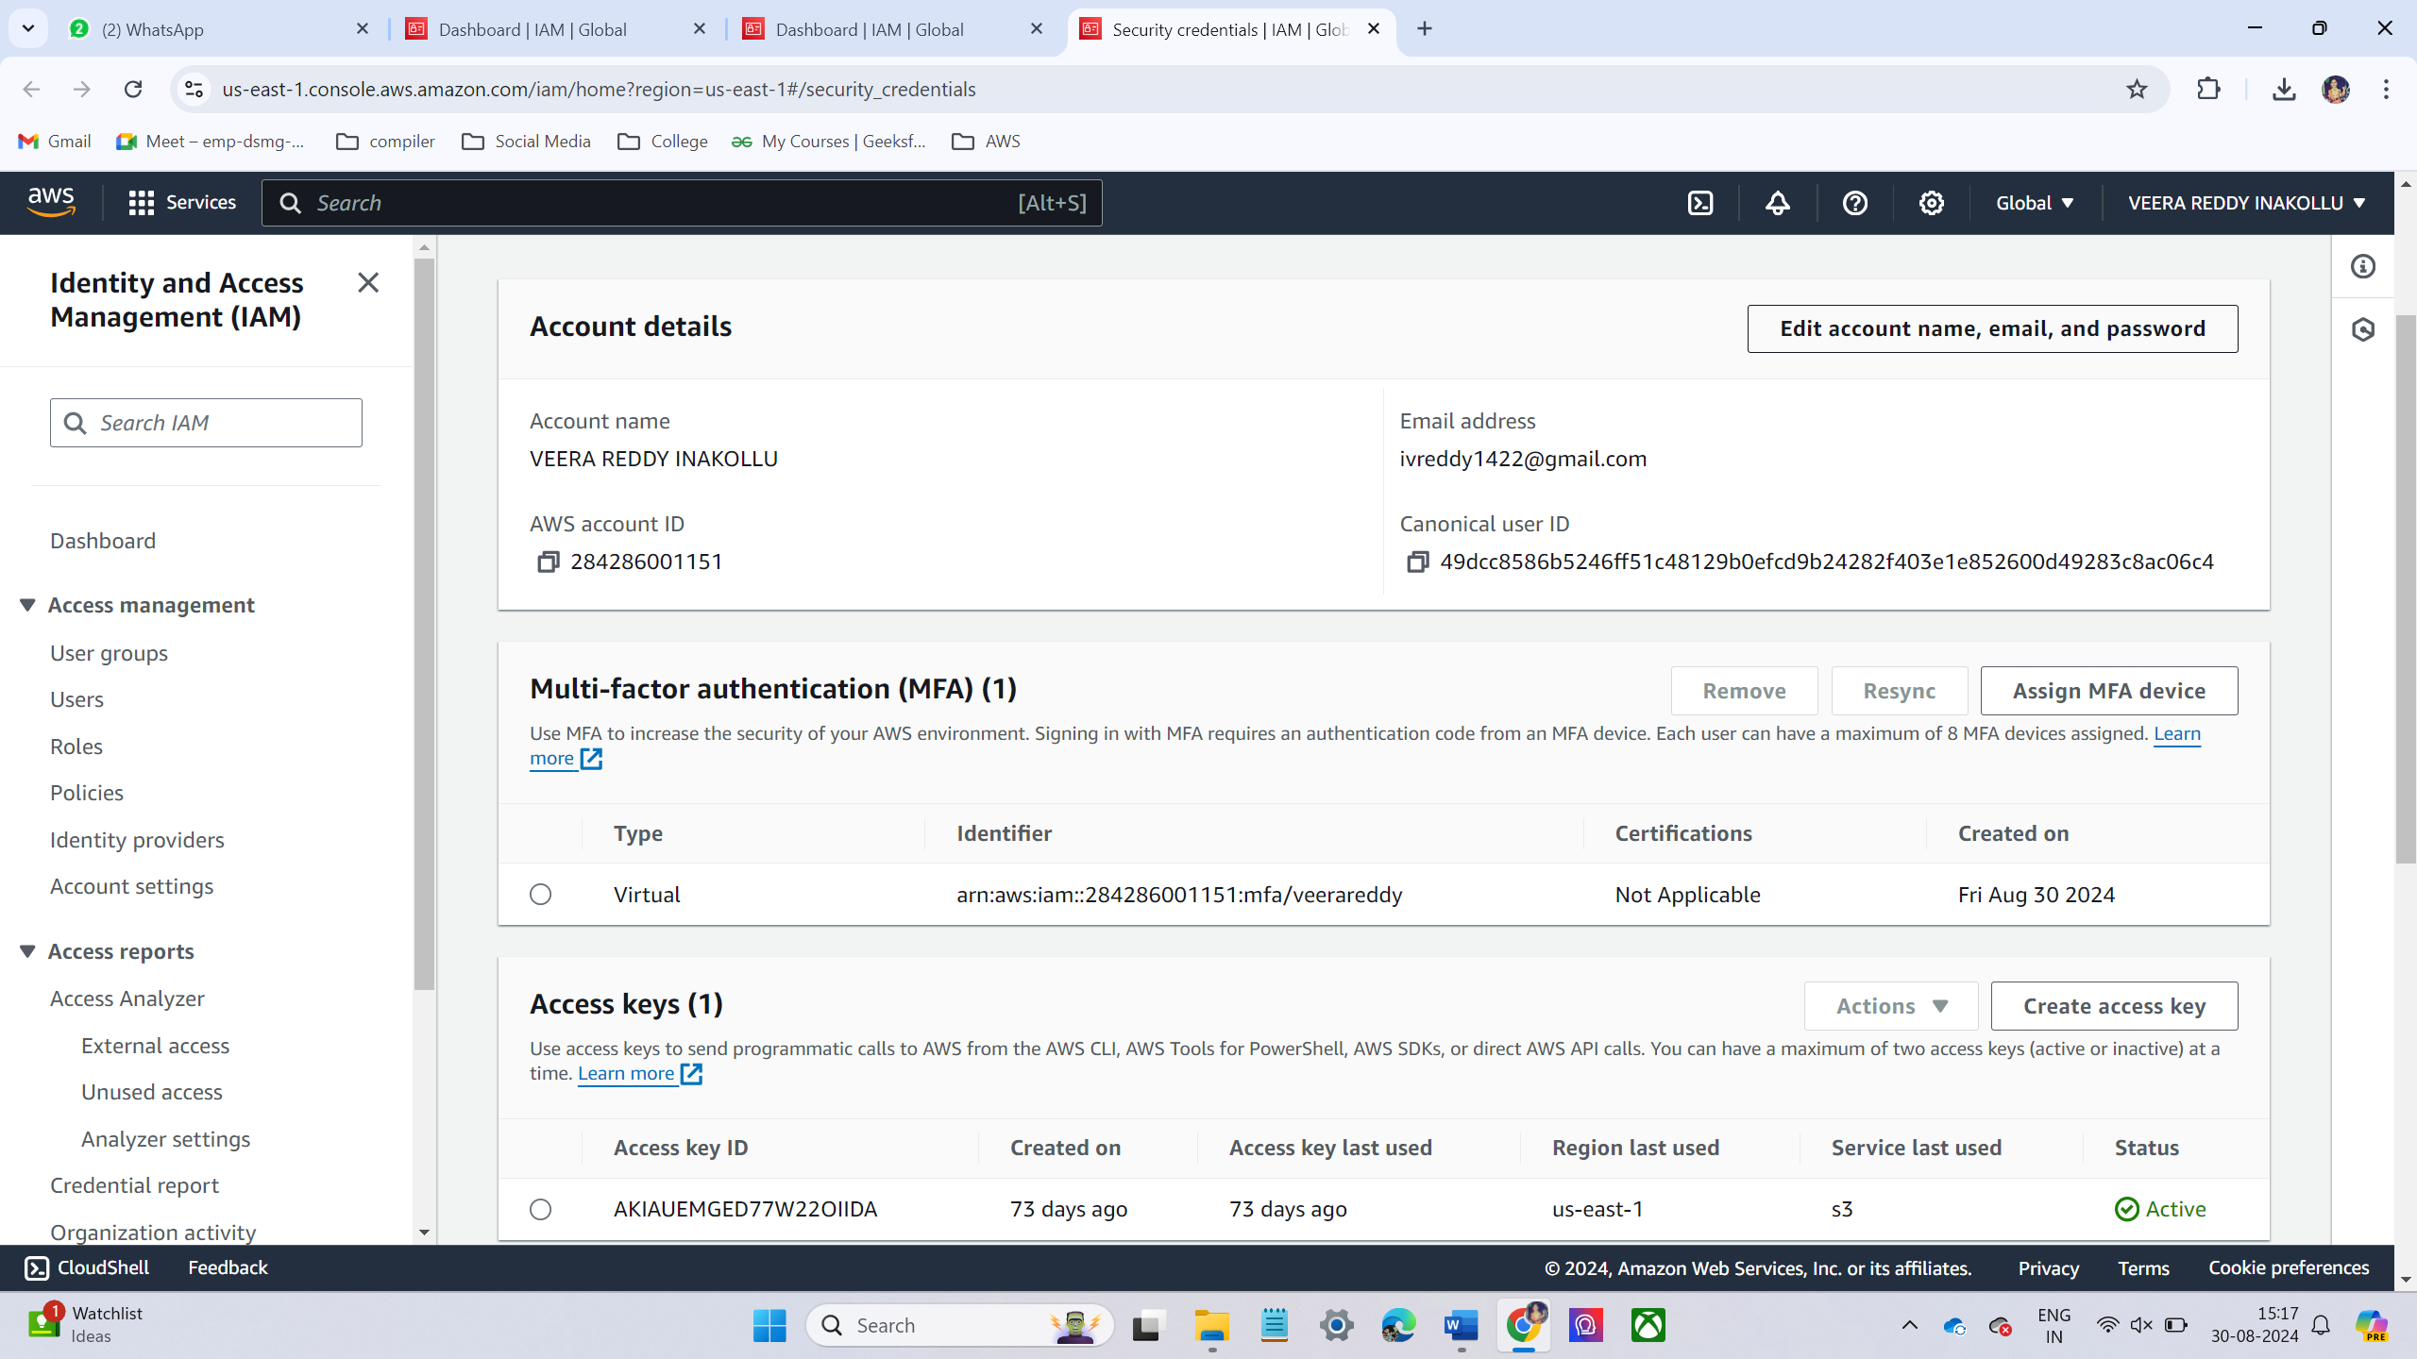
Scan the QR code in phone authenticator app.
After type two consecutive MFA codes.
I have successfully created the MFA for root user.

Slide 6
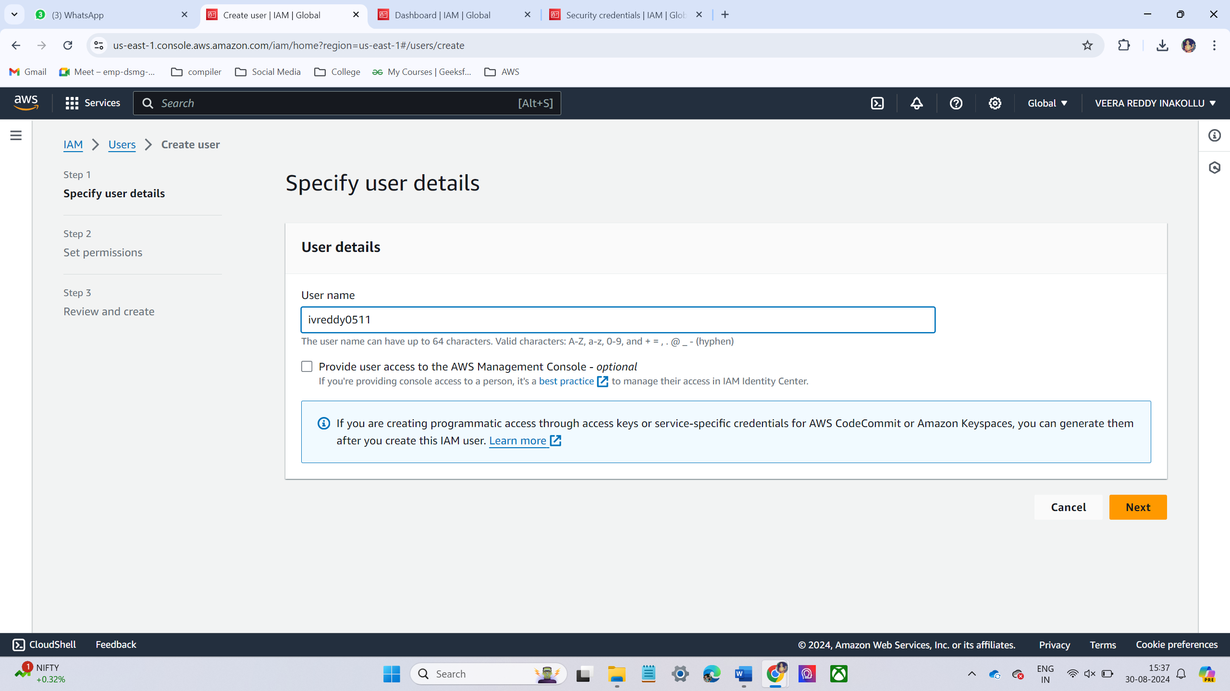
CREATE NEW IAM USER:
Sign in to AWS account
Navigate to IAM Service
On IAM service on the left-hand menu, select user and click Add user.
Specify the user details like username and access type

Slide 7
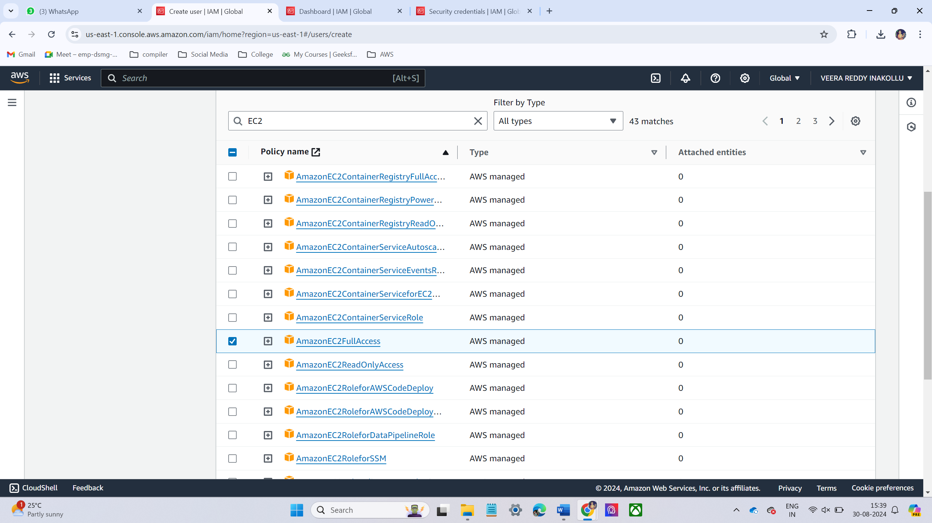
Attaché policies
I have chosen only EC2 full access permissions and then click next then create.

Slide 8
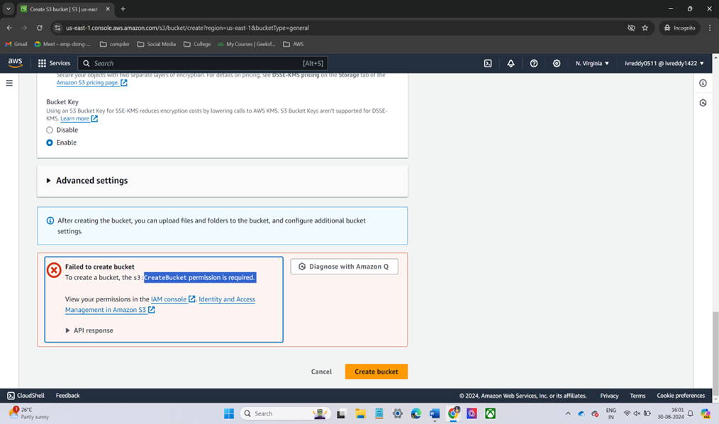
Now we can login into IAM user now try to create s3 bucket
When we are creating s3 bucket it shows an error create bucket permission required

Slide 9
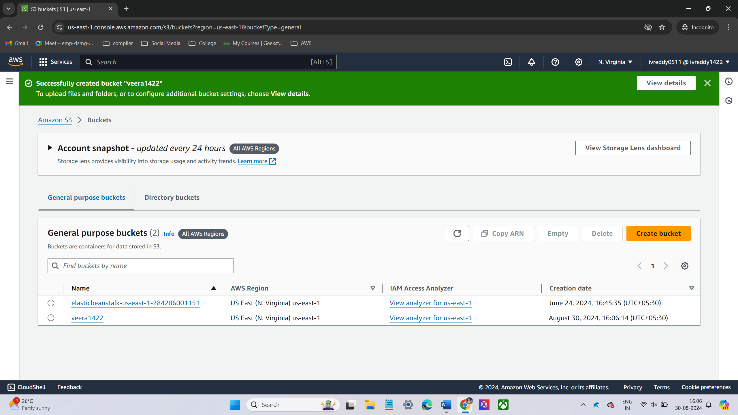
Now we are again login into root user
Now we are given full admin access to the IAM user.
Now login to IAM user try to create s3 bucket
Now I am successfully created s3 bucket

Slide 10
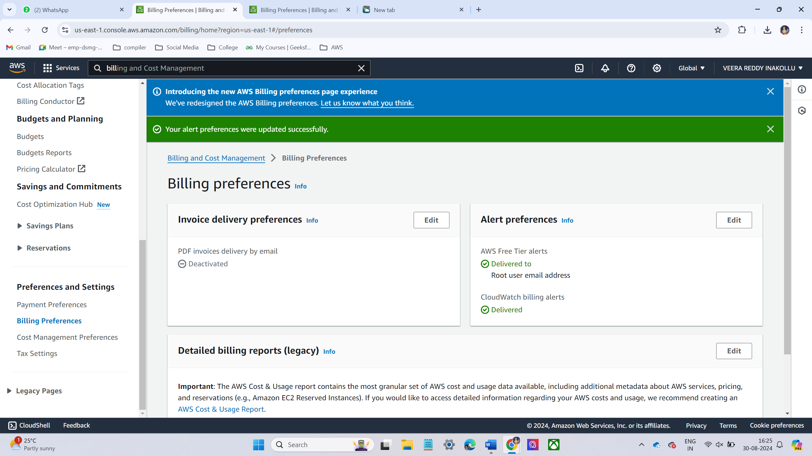
LAB – 2 – BILLING ALARM
Go to the Billing and cost management home.
On the left-hand side, under Billing preferences, enable the checkbox next to Receive Billing Alerts.

Slide 11
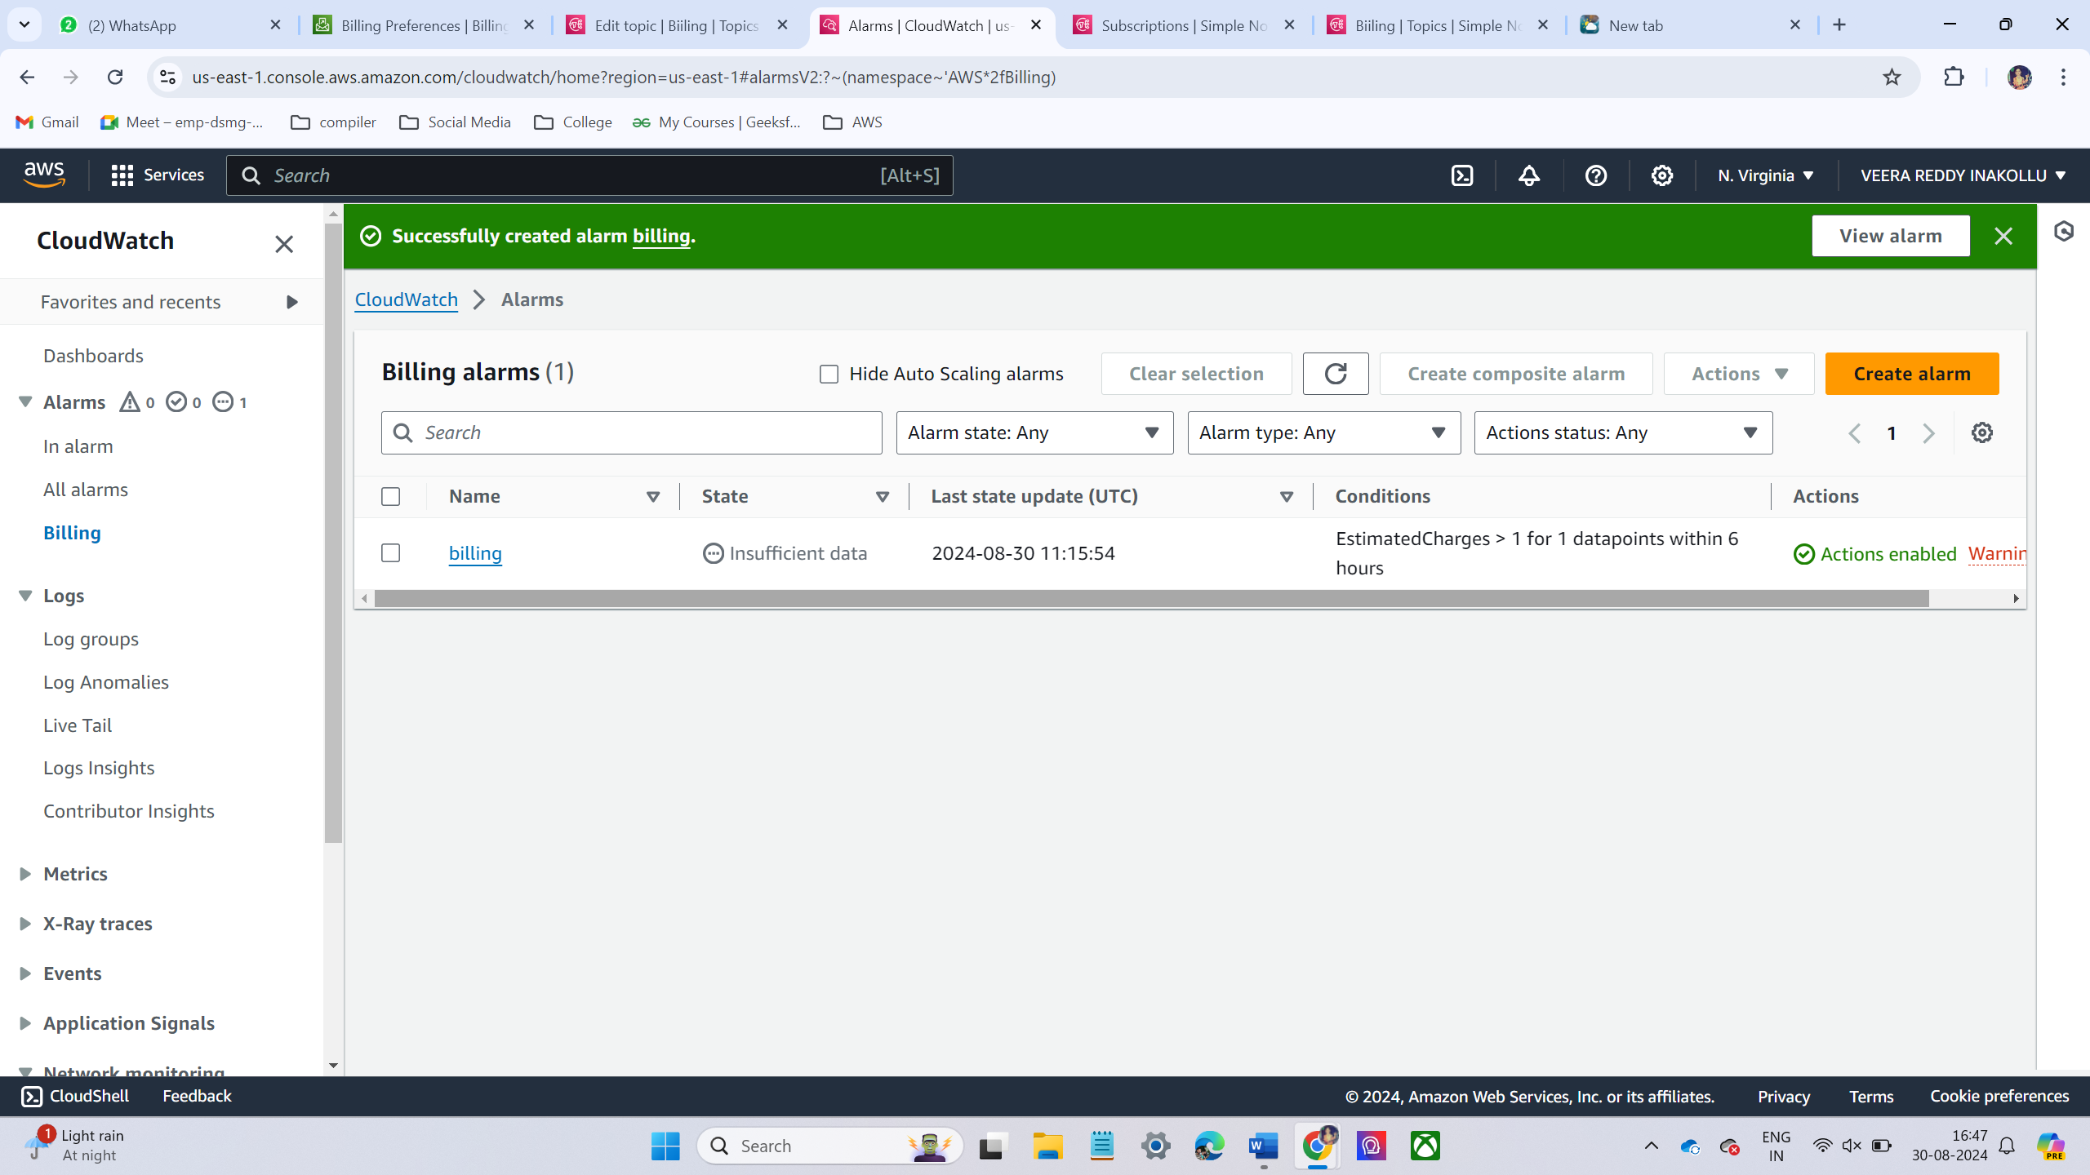
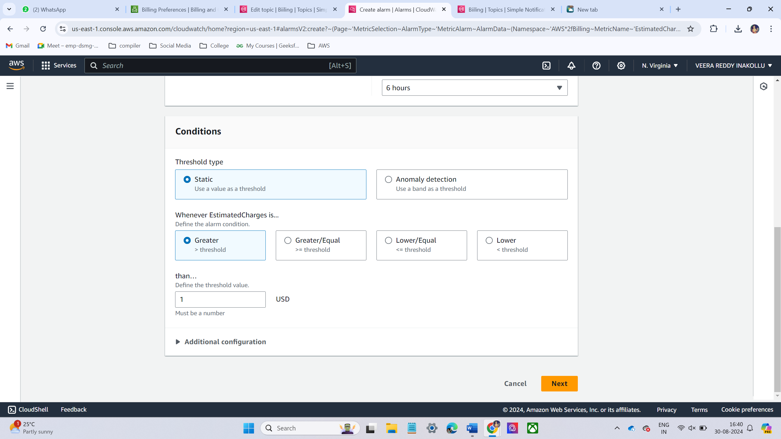
NOW CREATE ALARM FOR BILLING
Then go to cloud watch and click alarms
Under Create Alarm, click Select metric.
In the new window, click Billing from the list.
Select Total Estimated Charge. This tracks the total estimated charges for your account.
I have choose threshold value is $1
Now I have successfully created billing alarm.

Slide 12
LAB – 3 – S3 BUCKET
Amazon S3 (Simple Storage Service) is a highly scalable, reliable, and secure object storage service.
MAIN FEATURES :
Scalability: S3 can store and retrieve any amount of data at any time, making it suitable for large-scale applications.
Durability: S3 is designed for 99.999999999% (11 nines) durability, ensuring that data stored is highly resilient to failures.
Availability: S3 provides high availability for objects, with options to replicate data across multiple regions to increase fault tolerance.
Security: S3 offers several security features, including encryption (server-side and client-side), fine-grained access control (IAM roles, policies, bucket policies, and ACLs), and auditing through AWS CloudTrail.
Versioning: S3 allows you to keep multiple versions of an object, which helps in preserving, retrieving, and restoring every version stored in an S3 bucket.

Slide 13
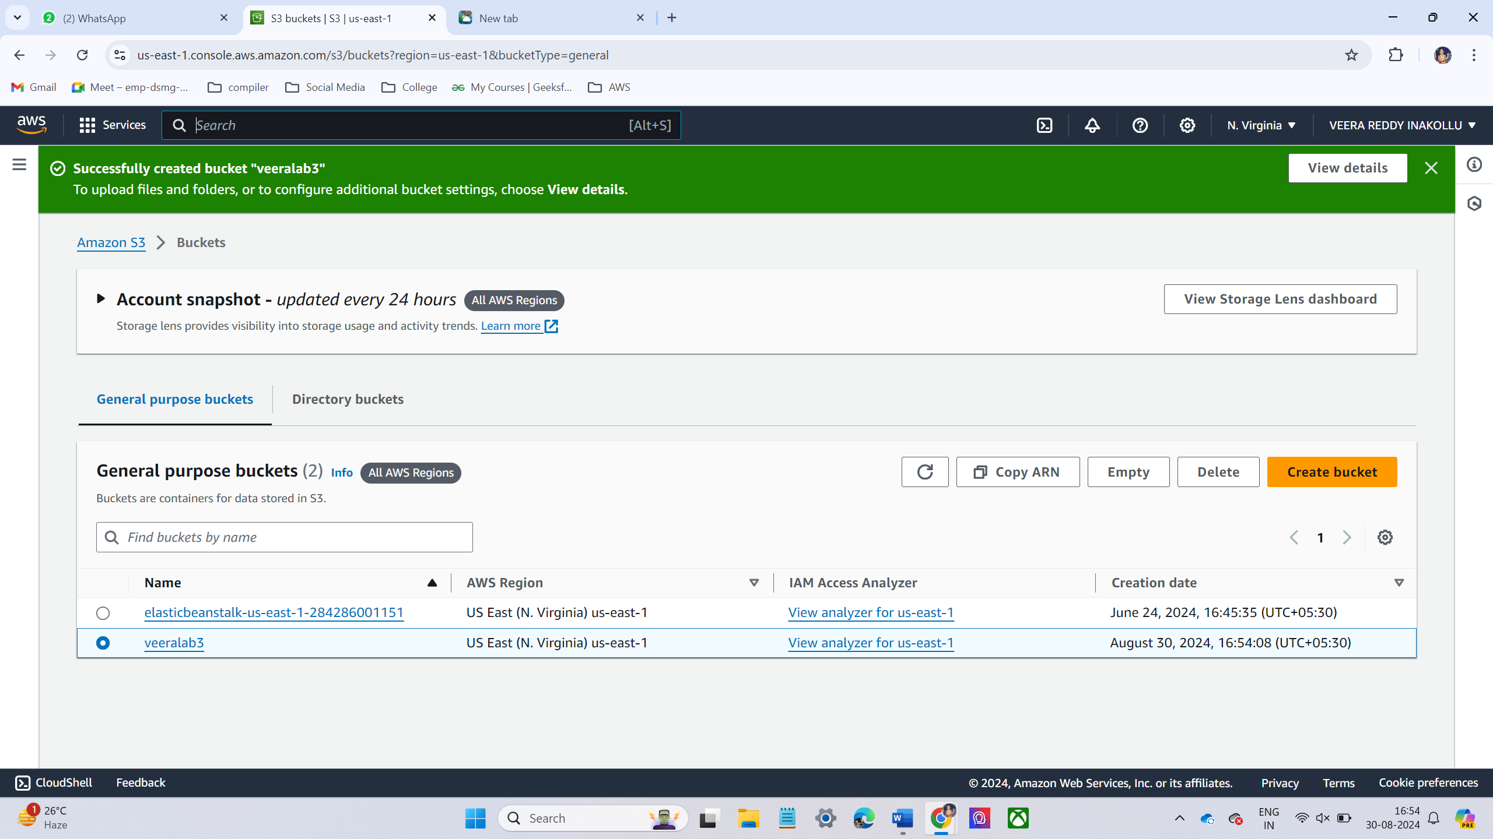
CREATING S3 BUCKET
Create S3 bucket. Make sure that to give unique name

Slide 14
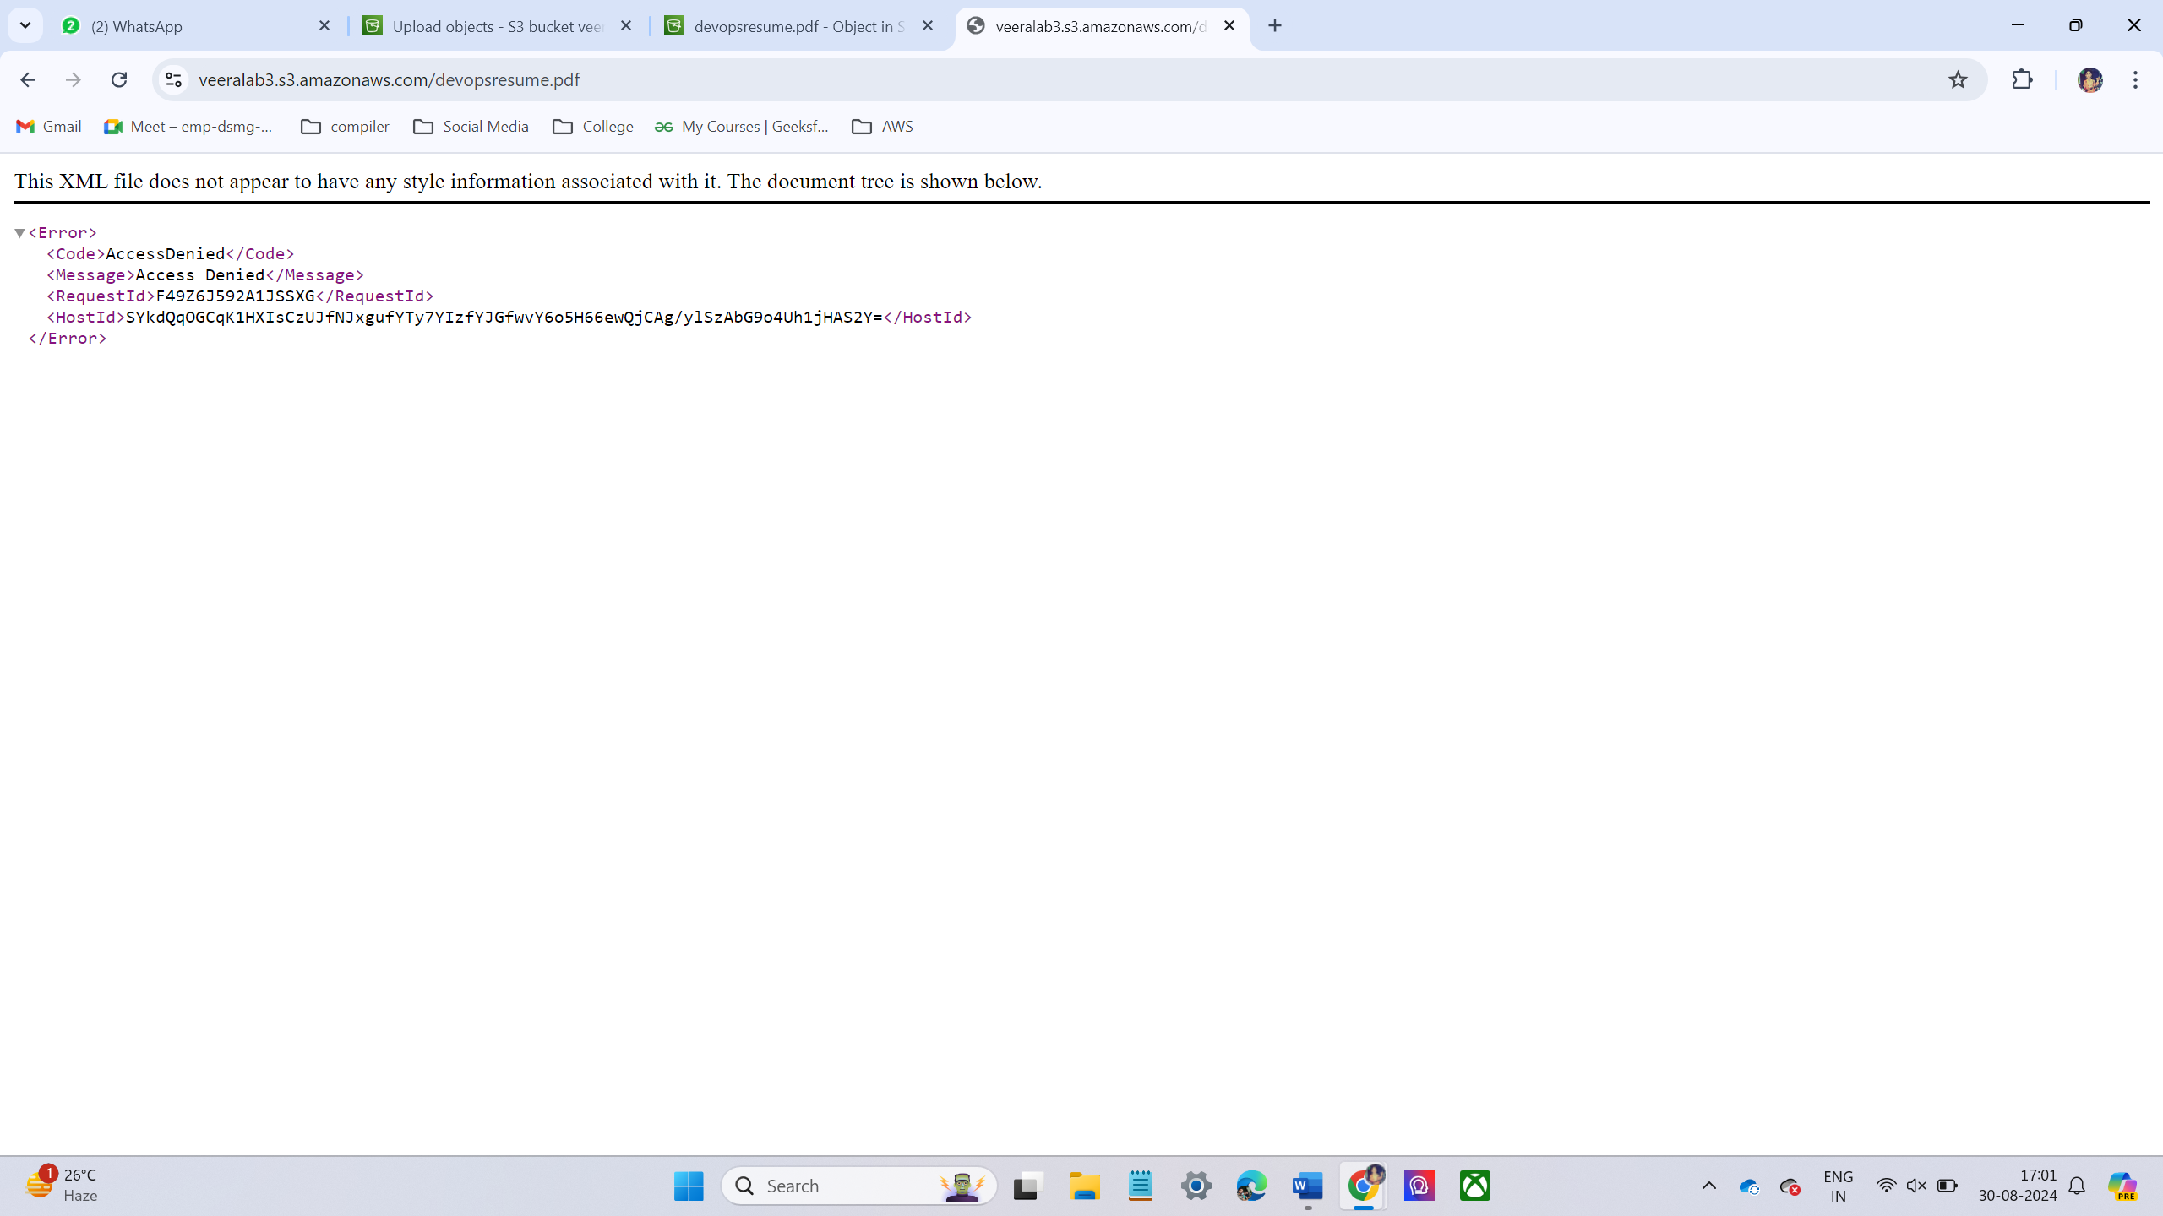
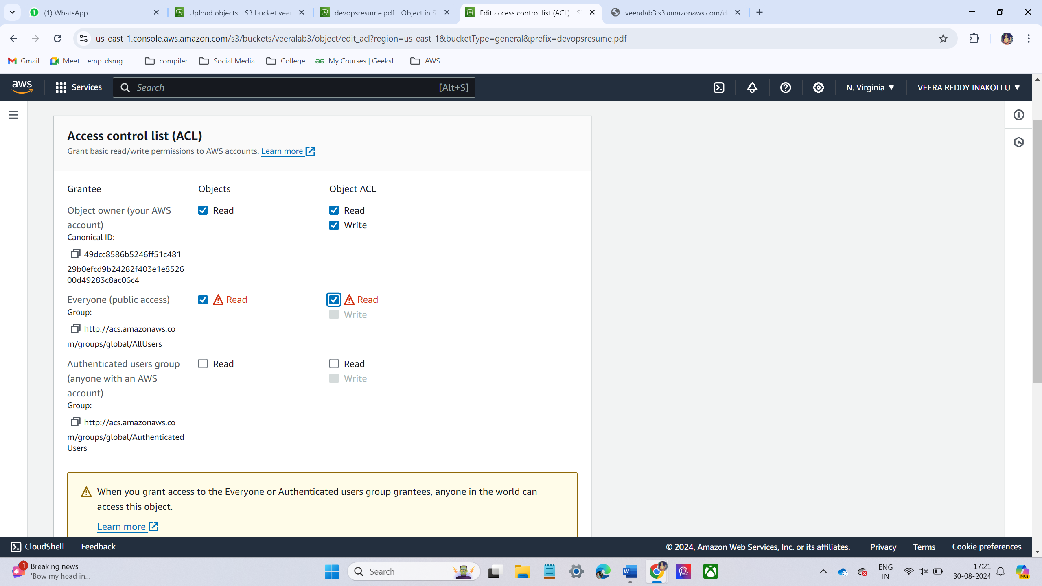
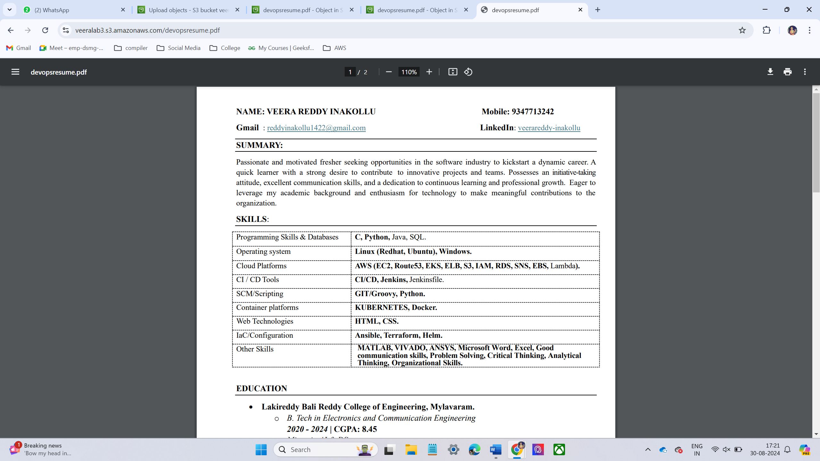
Now we can upload some files into the bucket.
Now Just copy the file url and browse the click it shows an error. Because the file is not public access permissions.
Now give the permissions
First give permissions to the bucket. Go to bucket under bucket go to permissions tab. In permissions tab disabled block public access. Then scroll down to up to Access control list (ACLs), then click edit give public access.
Now go to inside the bucket click the file and go to permission tab give the public access
Now copy the file url and browse the url it will display.

Slide 15
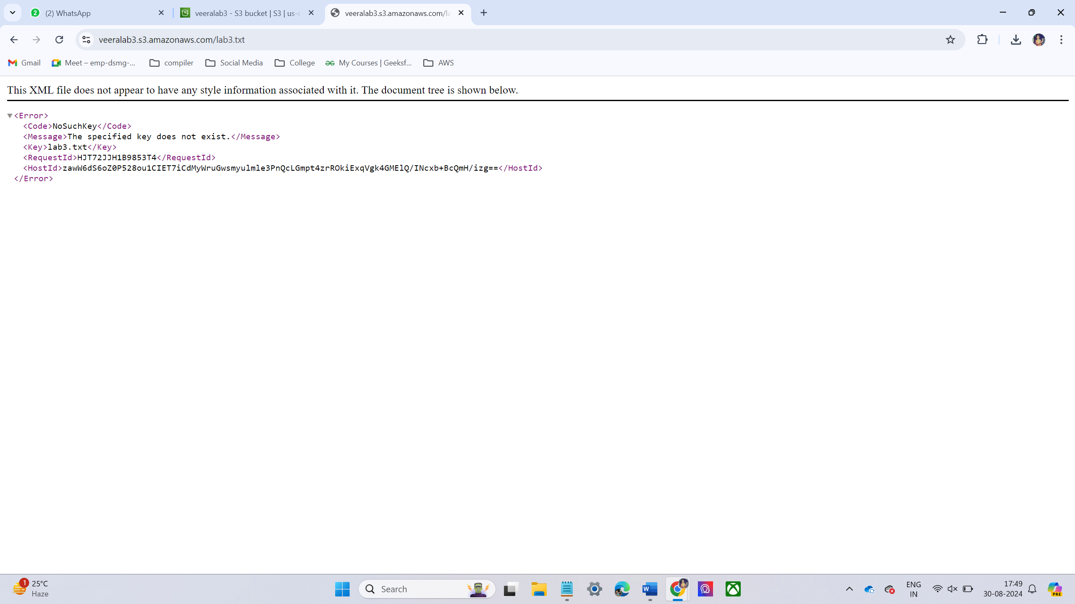
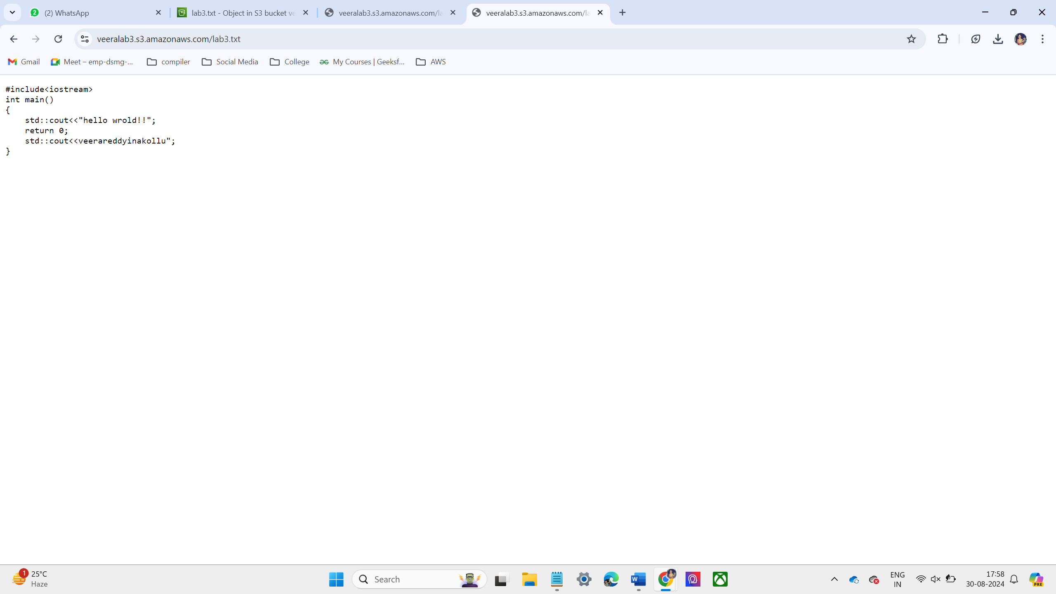
Enable the versioning of the excited bucket
Upload some text file in the versioning bucket
Now edit the file and update the file and upload the file again and now check the updated content
Delete text file from the bucket
Then Browse the previous URL it’s shown an error.
To recover the deleted file by using version technology. We are previously added versions in the bucket.
Then enable the version. In that place we have seen the deleted files then select the file and deleting it will restore the last updated file.
Then browse the URL it will display the content of the file.

Slide 16
LAB – 4 – EC2 INSTANCE ( ELASTIC COMPUTE CLOUD)
KEY FEATURES :
Elasticity: EC2 allows you to scale compute capacity up or down based on demand. You can quickly add or remove instances as needed to handle traffic fluctuations.
Variety of Instance Types: EC2 offers a wide range of instance types optimized for different use cases, such as compute, memory, storage, or GPU-intensive applications (e.g., General Purpose, Compute Optimized, Memory Optimized, Storage Optimized).
High Availability: EC2 instances can be deployed across multiple Availability Zones (AZs) to ensure fault tolerance and minimize downtime during infrastructure failures.
Auto Scaling: EC2 Auto Scaling automatically adjusts the number of EC2 instances in response to changing demand, helping to optimize performance while minimizing costs.
EC2 types:
On-Demand Instances
Reserved Instances
Spot Instances
Savings Plans

Slide 17
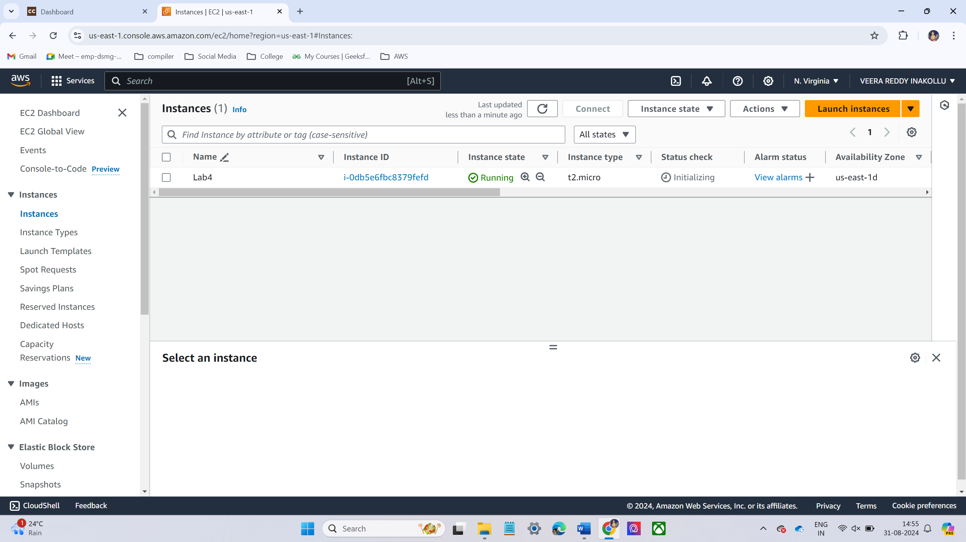
CREATING EC2 INSTANCE
Go to ec2 console and launch ec2 instance.
Now I have select Ubuntu operating system.
Instance type t2.micro
Allow required port in the security group it can access from the outside
Now Launch instance

Slide 18
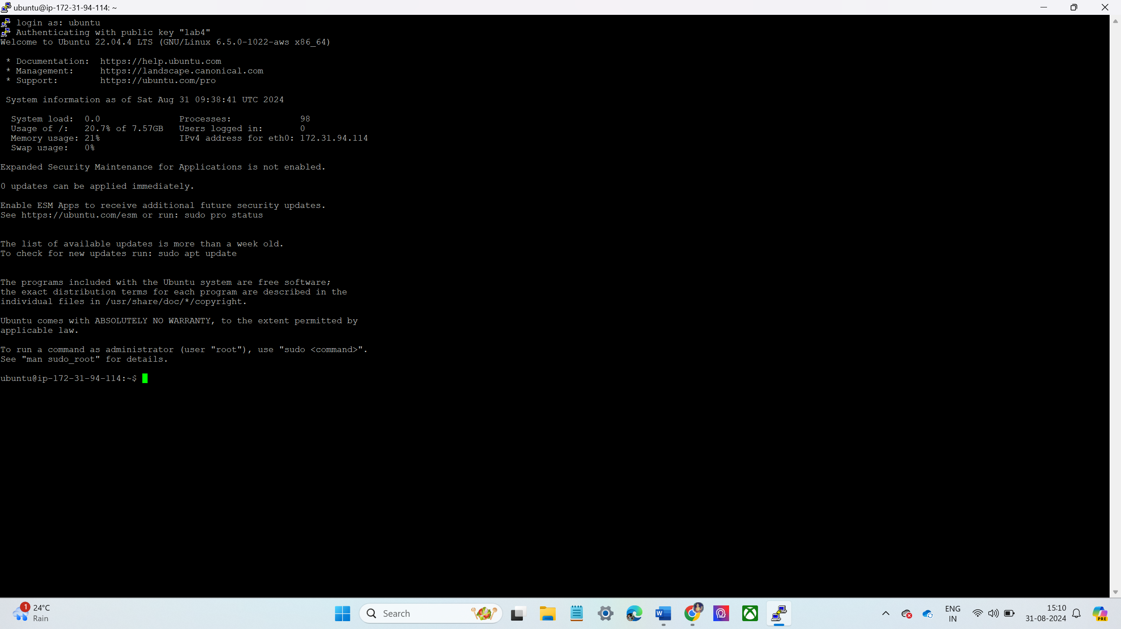
Now I have access instance using ppk file in putty software.

Slide 19
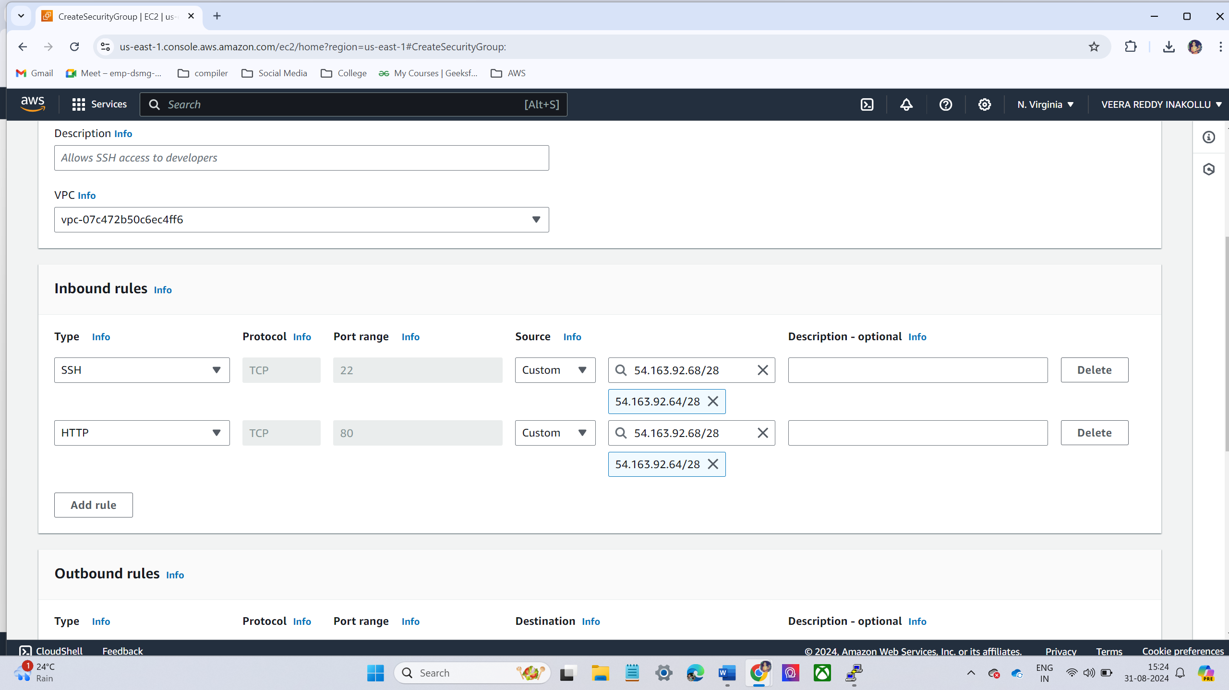
LAB – 5 – SECURITY GROUPS:
In AWS, Security Groups act as virtual firewalls for EC2 instances to control incoming and outgoing traffic. They help enhance the security of resources in VPC by filtering traffic based on rules.
CREATING SECURITY GROUP :
Goto ec2 console and click security groups and select new security group
Choose the name of the security group
And select your VPC.
Click Edit Inbound Rules
Type: SSH
Protocol: TCP
Port Range: 22
Source: Select My IP and adjust to IP/28 range
Type: HTTP
Protocol: TCP
Port Range: 80
Source: Set the same IP range

Slide 20
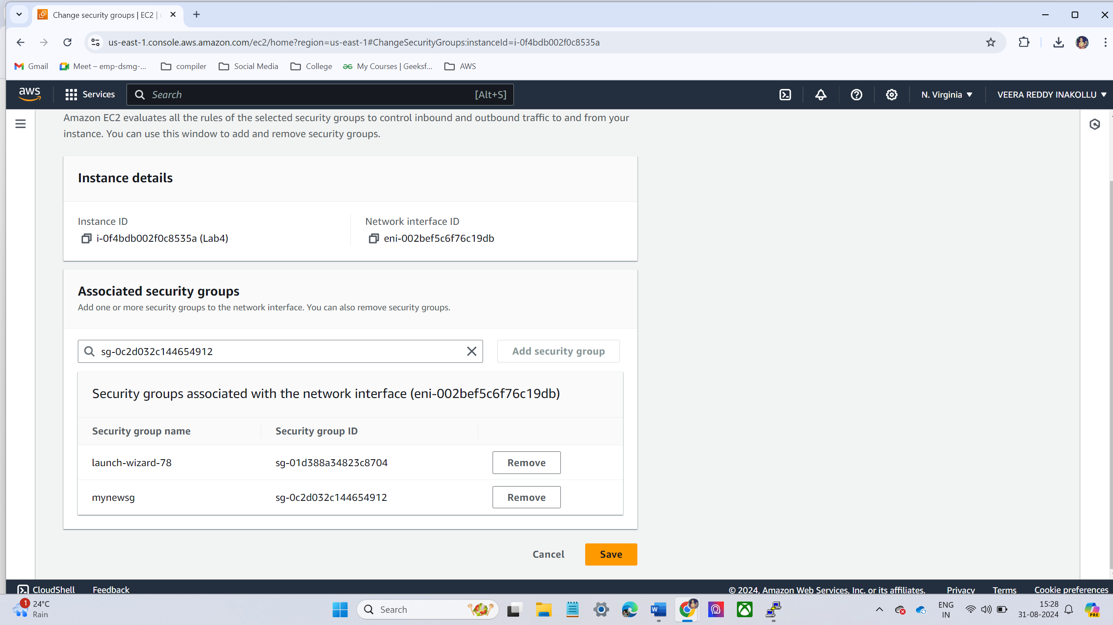
Now the new security group add to the existing EC2 instance
Go to EC2 Dashboard
Click Instances and select the instance you want to modify
Under Actions, select Networking → Change Security Groups
Attach mynewsg to your instance and apply the changes

Slide 21
LAB – 6 -VOLUMES AND SNAPSHOTS
In AWS, Volumes and Snapshots are key components of Amazon Elastic Block Store (EBS), providing persistent block storage for EC2 instances
How Volumes and Snapshots Work Together:
Backup and Restore: Snapshots are primarily used to create backups of EBS volumes. In case of data corruption or failure, you can use a snapshot to restore a volume to a previous state
Volume Cloning: Snapshots allow you to create new EBS volumes with the same data, which can be useful for creating test or staging environments from production data
Cost Optimization: Since snapshots are incremental, you only pay for the storage of changed data, not the entire volume size, reducing overall storage costs for backups.

Slide 22
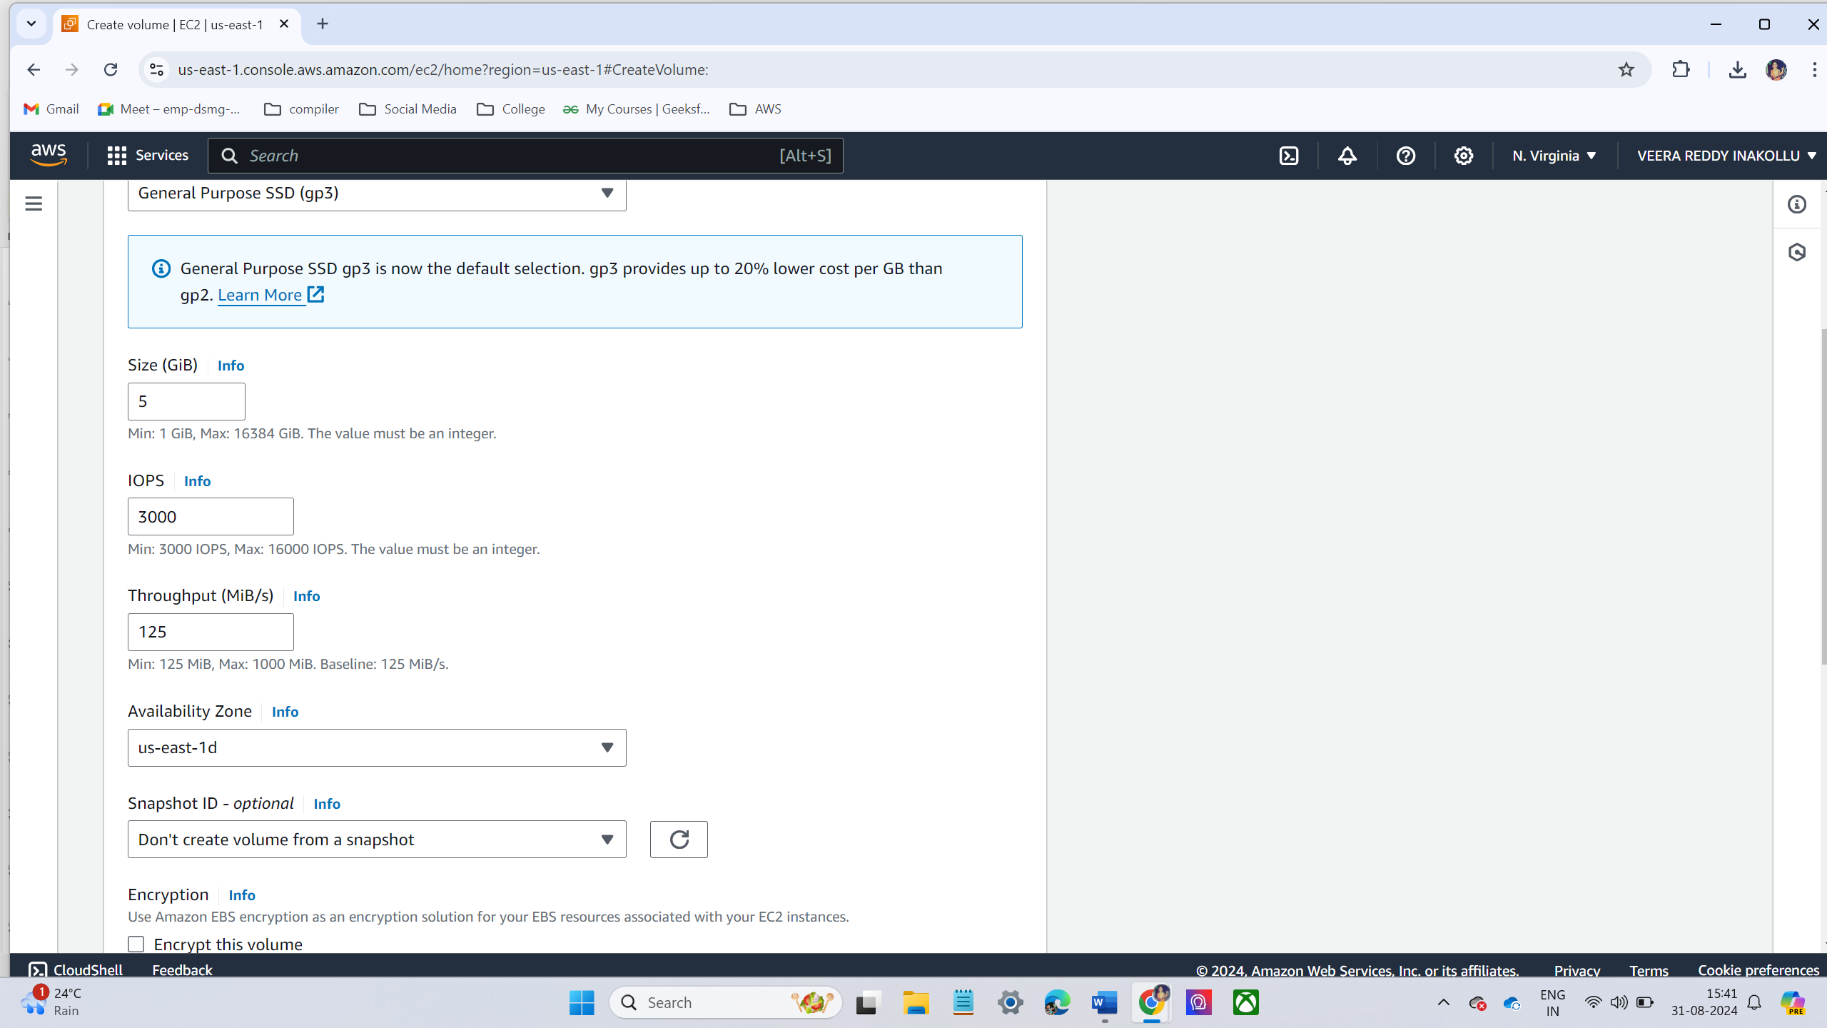
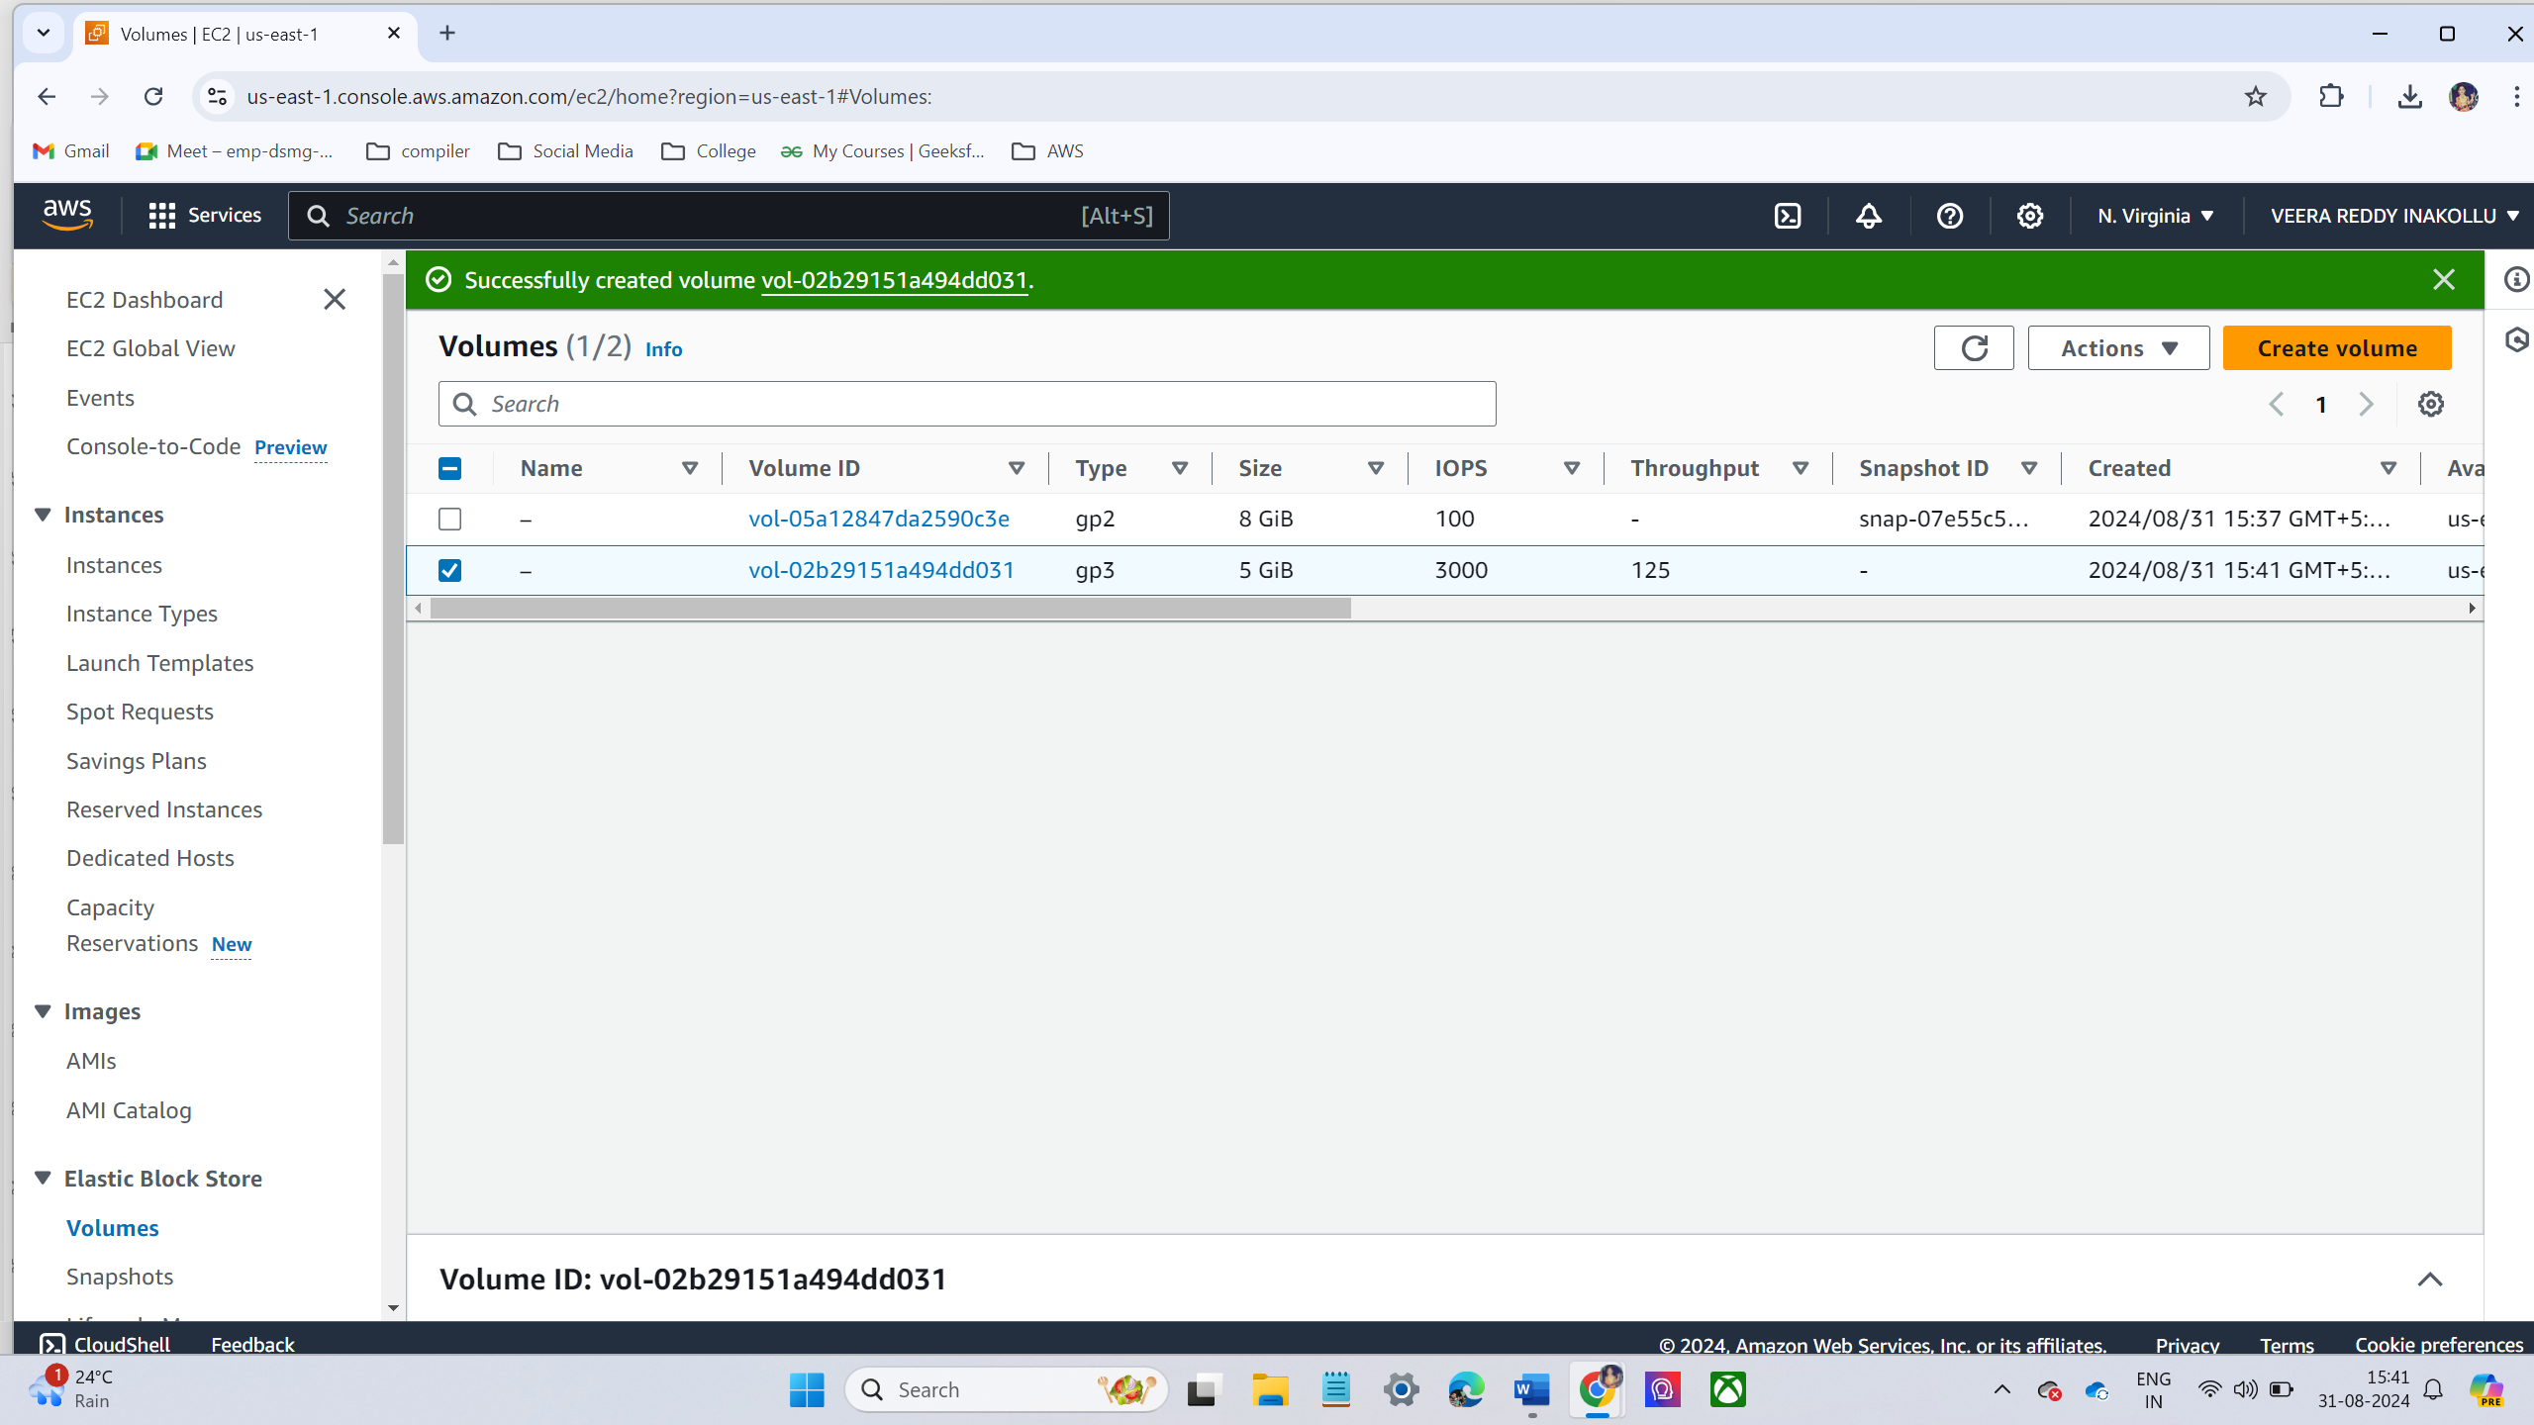
CREATING VOLUME AND ATTACH TO EC2 INSTANCE :
click on Volumes under Elastic Block Store (EBS).
Click Create Volume
Size: 5 GiB
Availability Zone: Select the same Availability Zone as your running EC2 instance.
Volume created successfully

Slide 23
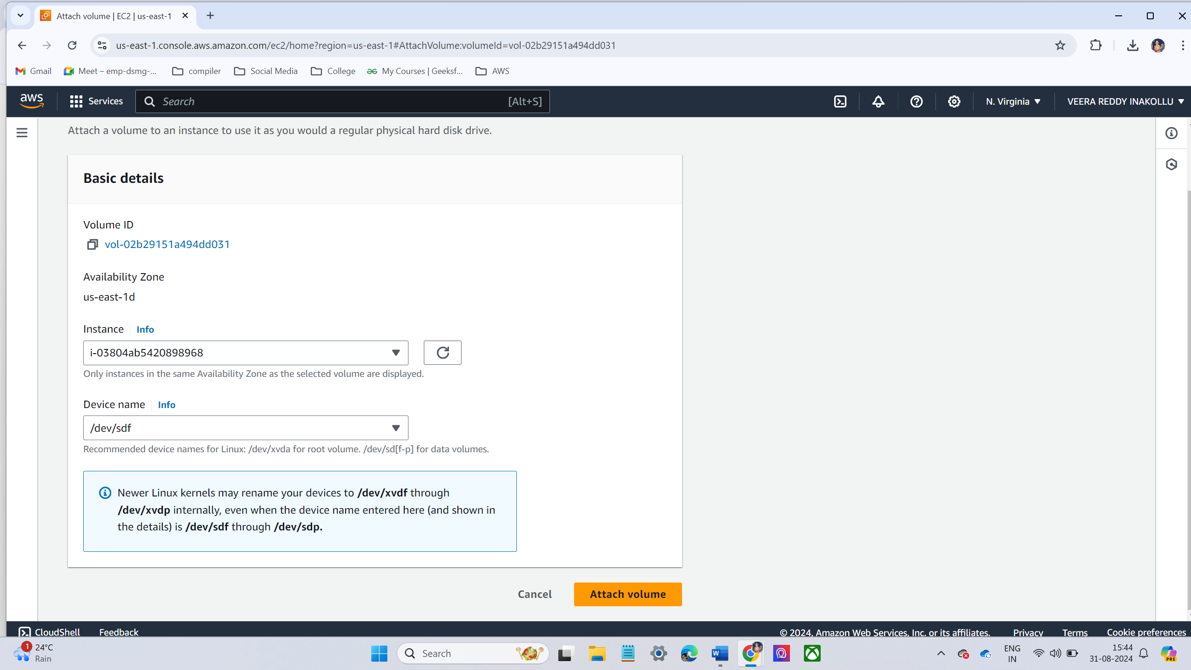
Once the volume is created, select the instance from the list and click Actions → Attach Volume

Slide 24
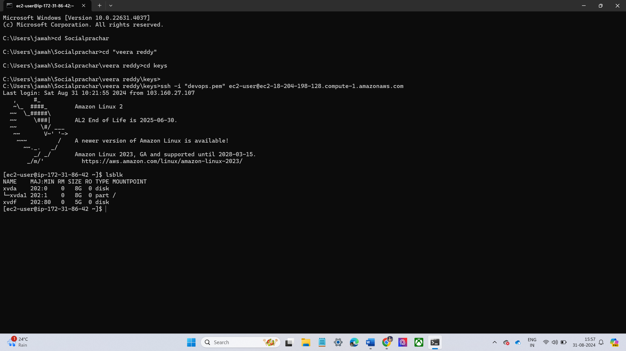
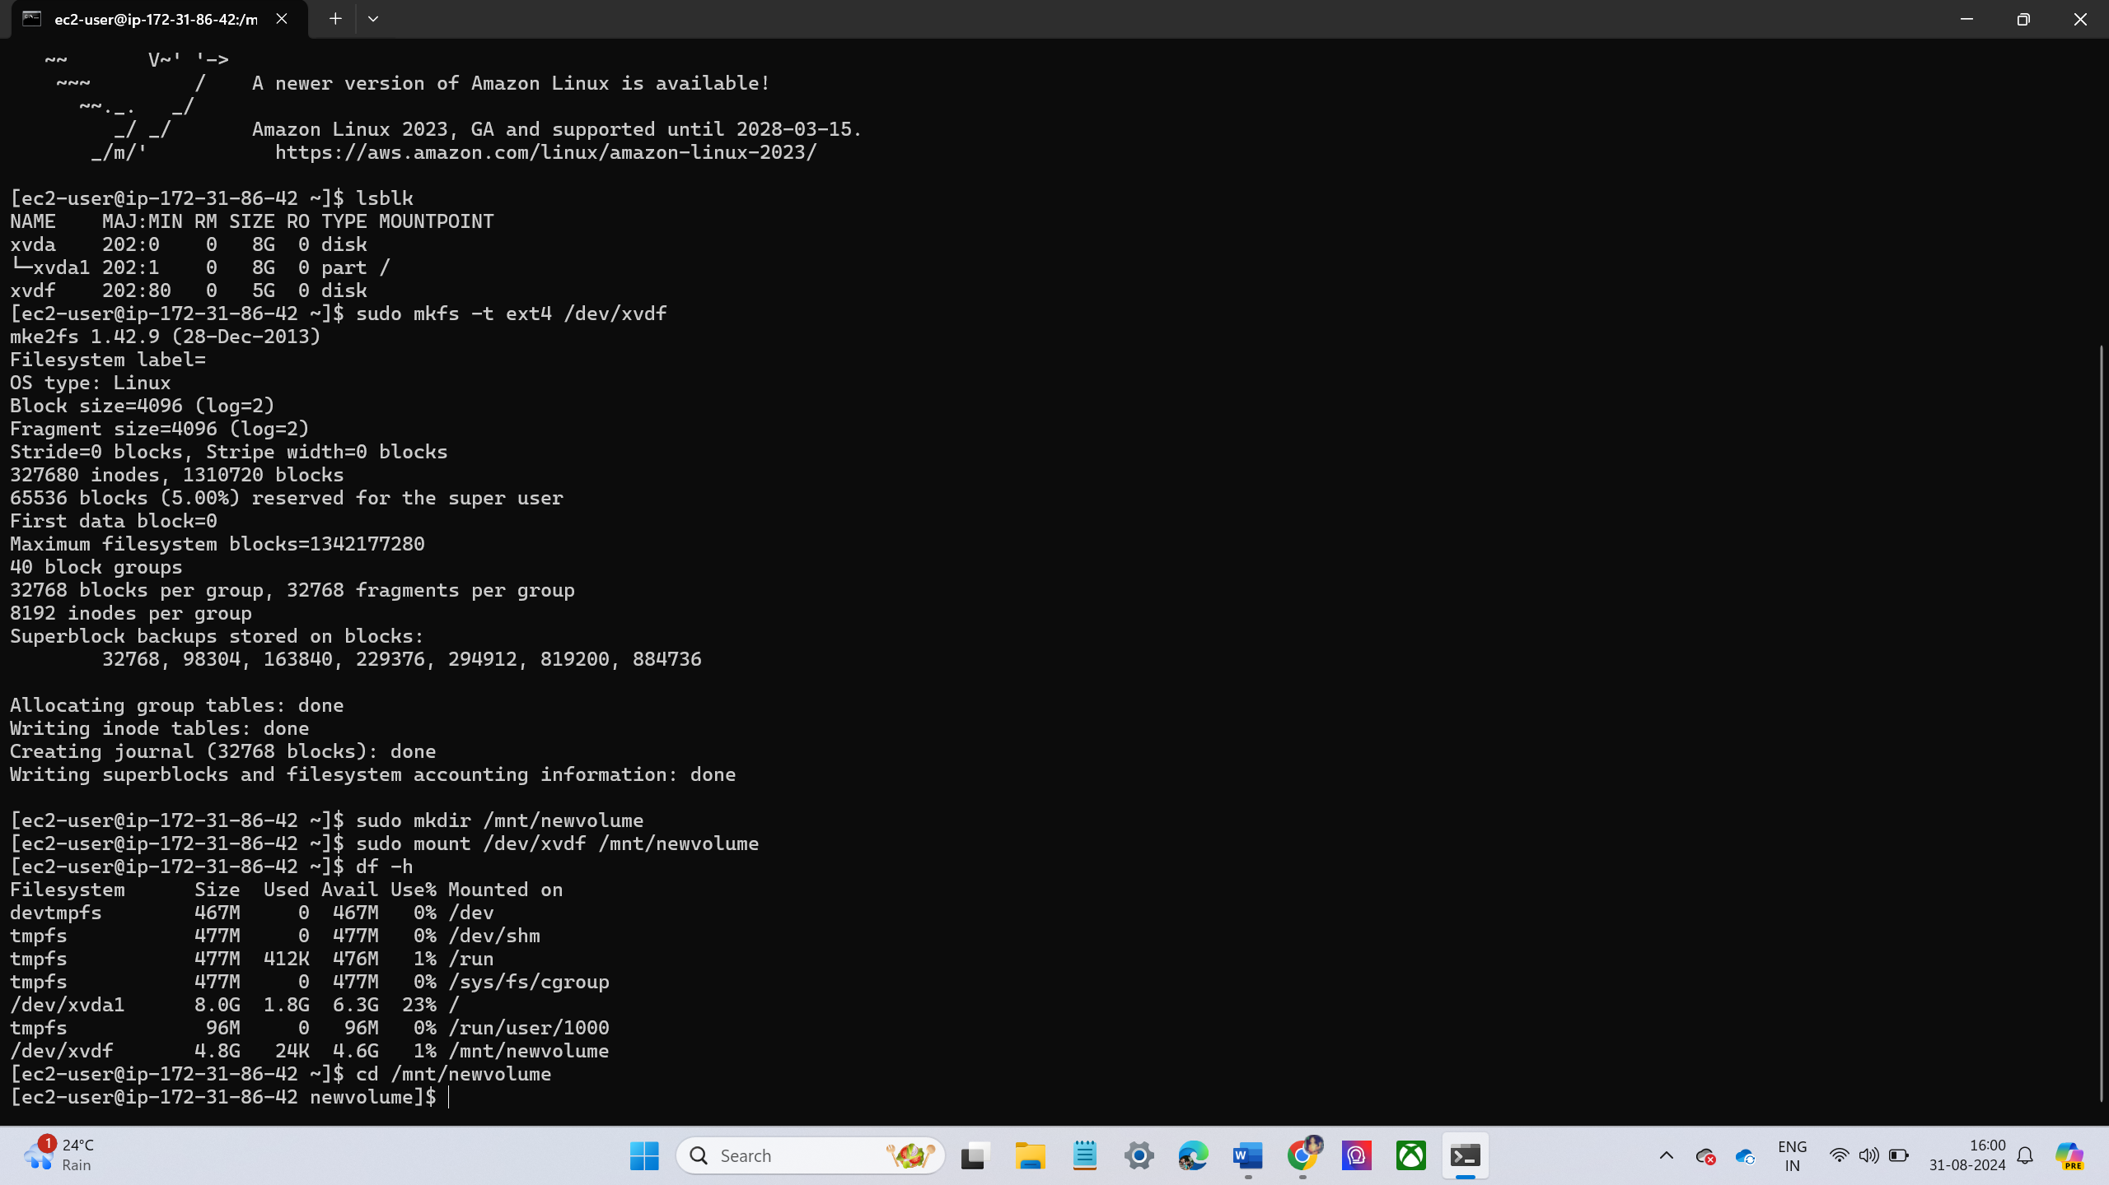
Connect the ec2 instance in the terminal using ssh command
Run the following command to check if the volume is attached
Lsblk
Create a mount point
Mount the new volume
Verify the volume is mounted

Slide 25
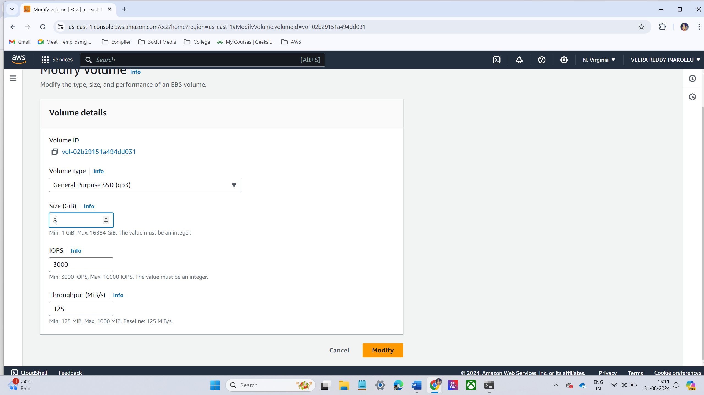
Go to the Mount directory
Create a some text files using touch command.
When I am creating files in first time I didn’t use sudo. They show an error be permission denied
Then after I use sudo it was created.
Increase the Size of the Volume to 8GB.
Select the volume created (5 GiB) and click Actions → Modify Volume
Change the size to 8 GiB and click Modify
Extend the file system to use the full 8GB: sudo resize2fs /dev/xvdf

Slide 26
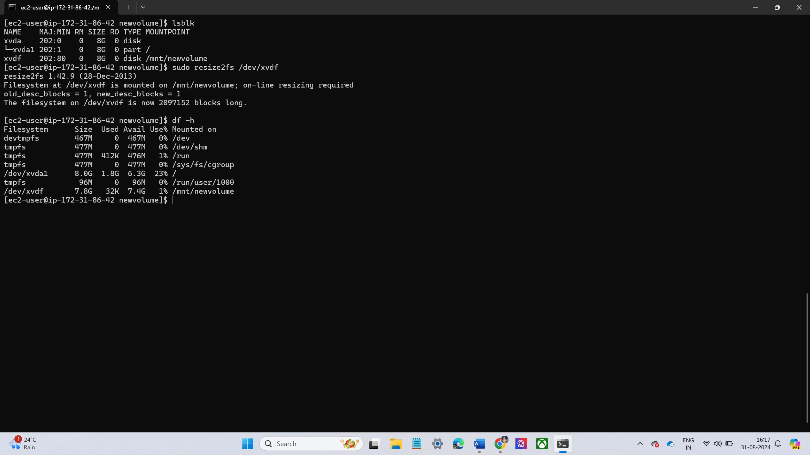
Take a Screenshot of the Volume and Delete It
Create a New Volume with the Snapshot and Attach It to the Server
Now again mount the volume and check the fles
It shows previous files

Slide 27
LAB – 7 – AMI – AMAZON machine image
In AWS, an Amazon Machine Image (AMI) is a pre-configured virtual machine template that contains the information needed to launch an instance (virtual server) in the Amazon Elastic Compute Cloud (EC2). An AMI serves as the blueprint for your EC2 instances and can include an operating system, application servers, and custom applications.
Custom AMI Creation:
You can create a custom AMI by configuring an EC2 instance to your desired state and then creating an AMI from it. This is useful for replicating environments or scaling applications with identical configurations.
Custom AMIs are often used to speed up deployment by pre-packaging software, security patches, and environment configurations.

Slide 28
CREATING AMI FOR EXCITING EC2 INSTANCE
Select the instance that you want to create an AMI of by clicking the check box next to it.
After selecting instance click actions button at the top of the page.
Under the image and template section, select the create image
Configure the image settings
Then click create image.
Once the image status is marked as available, the AMI can be used to launch new instances with the exact configuration of the original.

Slide 29
LAB – 8 – LOAD BALANCERS
In AWS, Load Balancers are part of the Elastic Load Balancing (ELB) service, which automatically distributes incoming application traffic across multiple targets (such as EC2 instances, containers, and IP addresses) in one or more Availability Zones. This ensures scalability, fault tolerance, and high availability for your applications.
Types of Load Balancer:
Application Load Balancer (ALB) in AWS is a service that operates at the Layer 7 (Application Layer) of the OSI model. It is designed to route and distribute incoming HTTP and HTTPS traffic across multiple targets, such as EC2 instances, containers, and Lambda functions
Network Load Balancer (NLB): it ideal for high-throughput and low-latency applications such as real-time gaming, IoT, and financial applications.
Gateway Load Balancer (GWLB):It is designed to simplify the deployment, scaling, and management of third-party virtual network appliances, such as firewalls, intrusion detection/prevention systems (IDS/IPS), and deep packet inspection systems.

Slide 30
CREATING LOAD BALANCER
Before creating load balancer we have create two ec2 instances and target group
Launch Two EC2 Instances
After launching instances install httpd and git and clone the two application each one having one application.
The two servers are hosted successfully.
Now we have creating Target Group
Navigate EC2 and under load balancing click target group
Now click create target group choose instances
Now choose the the above created two instances and click create target group

Slide 31
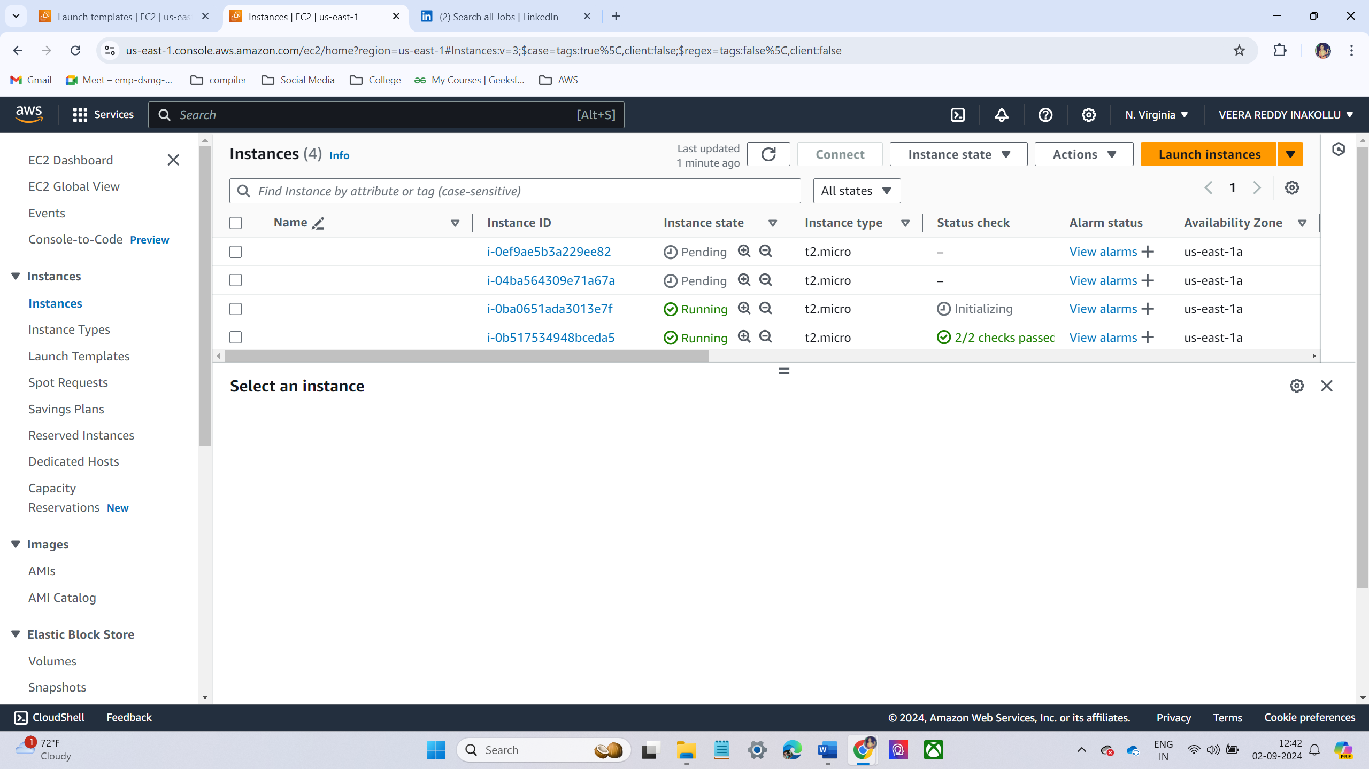
NOW I AM CREATING LOAD BALANCER
Set the Auto Scaling Group name and choose a VPC and Subnets where the instances should launch
Configure the Desired Capacity:
Min Capacity: 1
Max Capacity: 2
Review and click Create Auto Scaling group
Now check the instances it will be automatically created
Change Max Capacity and Verify Instance Launching
AWS will launch new instances to meet the updated capacity

Slide 32
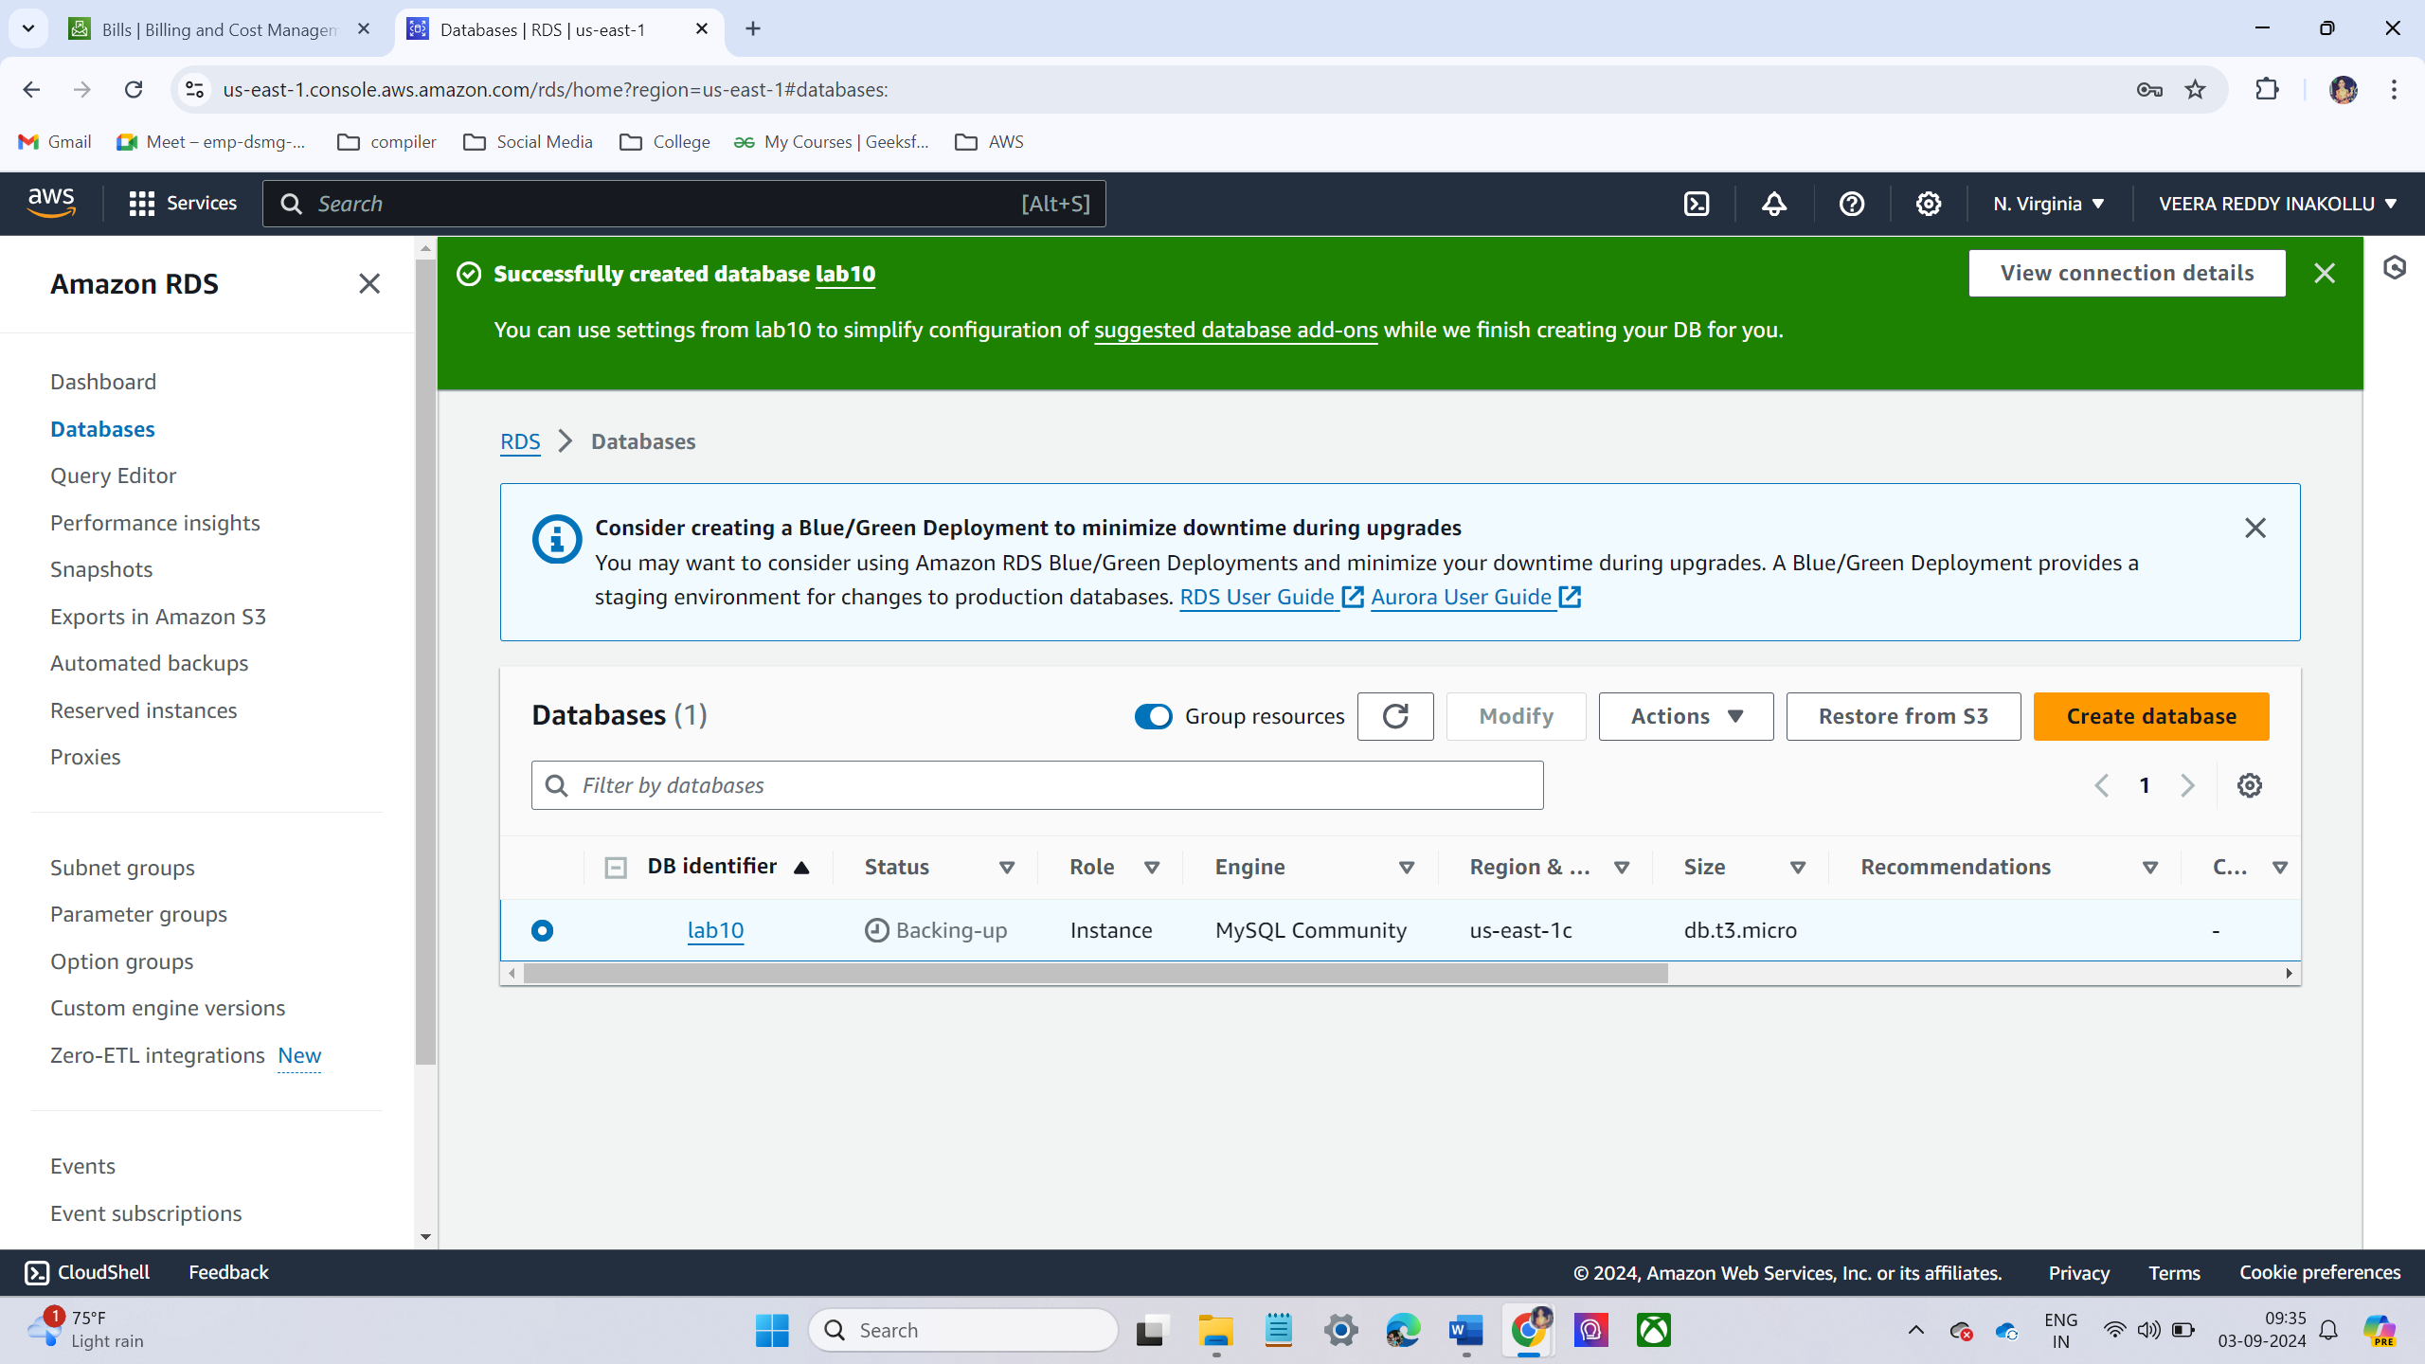
LAB – 10 - Provision an RDS Instance (MySQL)
RDS (Relational Database Service) instance with MySQL in AWS involves several steps. AWS RDS simplifies database management, making it easier to handle database operations like provisioning, scaling, backup, and monitoring.
CREATING RDS:
Choose standard create and MySQL.
Configure instance size db.t3.micro.
Choose VPC and subnets
Choose security groups. In security group we have enable port number 3306 in inbound rules
Database Created Successfully

Slide 33
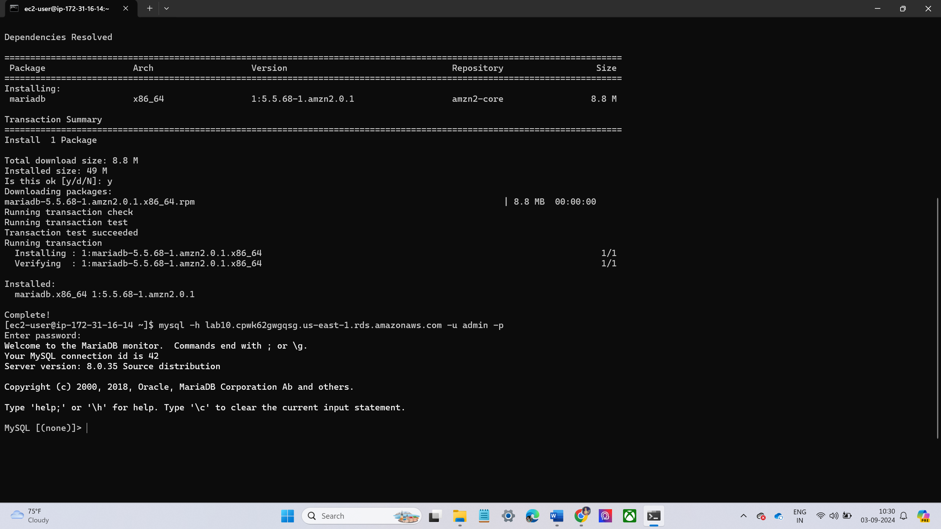
Now I have create ec2 instance
Now connect ec2 instance and rds using security group
Now launch EC2 instance and install MySQL
Now configure the database using command
Mysql –t <rds url> -u <username> -
Now enter password
It will successfully connect MySQL >

Slide 34


Slide 35
Any
Questions ?

Slide 36
RECENTLY I HAVE ATTEND AN INTERVIEW THEY ASKED SOME QUESTIONS LIKE THIS
WHAT IAM SERVICE
HOW YOU HAVE GIVE PERMISSION TO SOME PARTICULAR MEMBERS
WHAT ARE THE STORAGE TYPES IN EC2 INSTANCE
WHAT ARE THE DIFFERENT TYPES OF EC2 INSTANCE
WRITE SCRIPT TO LAUNCH EC2 INSTANCE

